Slide 1

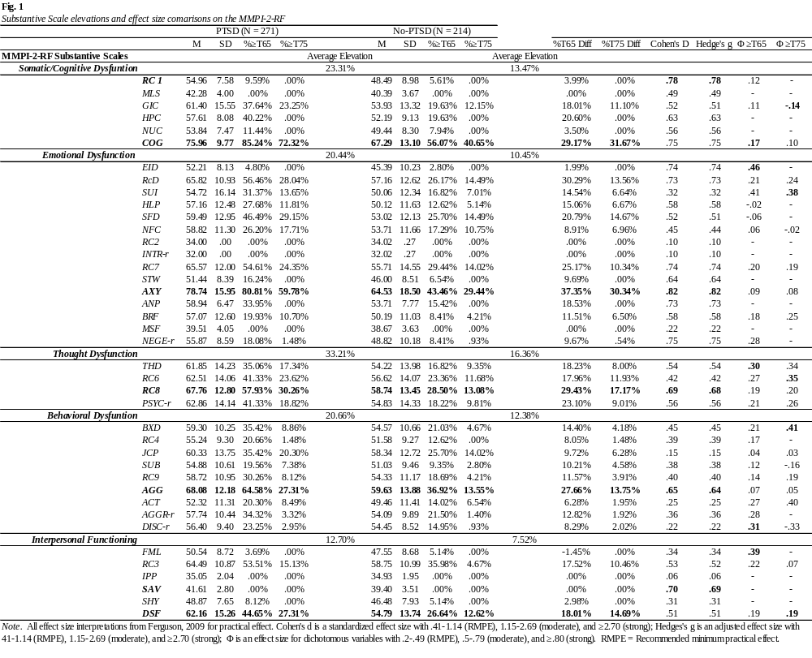
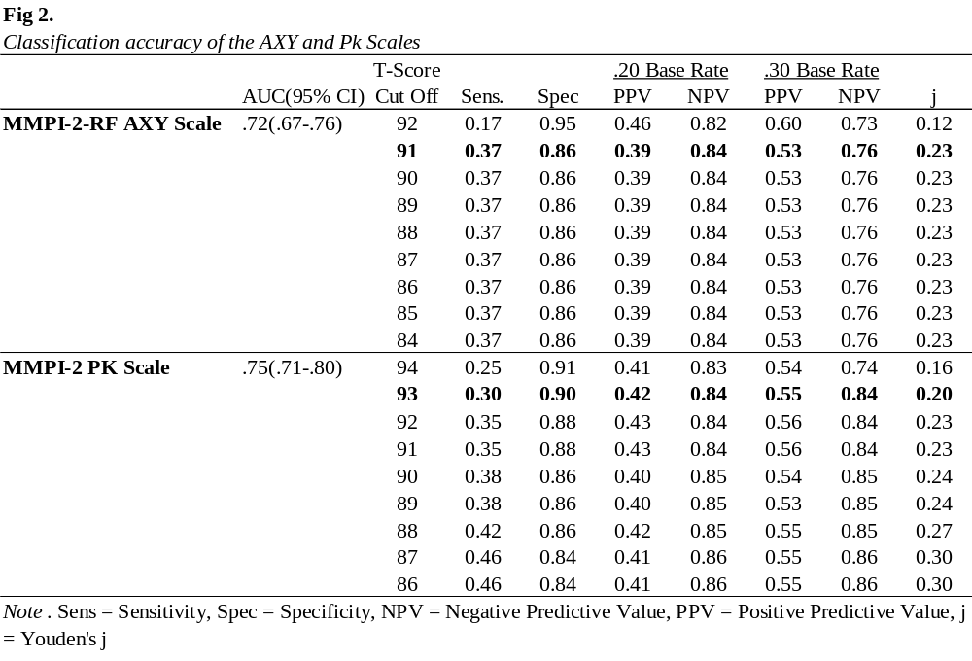
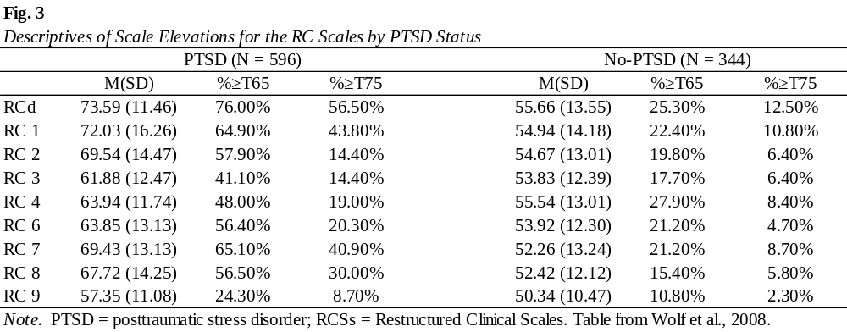
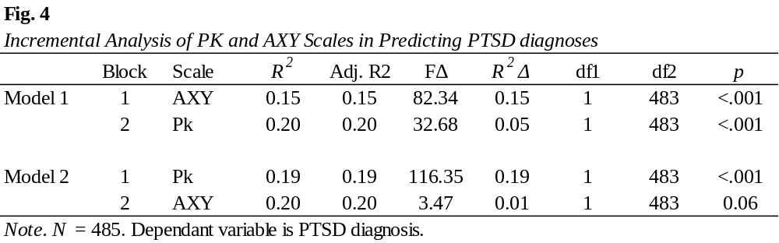
Identifying PTSD with the MMPI-2-RF Substantive Scales with
Active-Duty (AD) Personnel
Luke G. Childers, M.S.¹, Keegan J. Diehl, M.A. ¹, & Paul B. Ingram, PhD.^{1,2}
¹ Department of Psychological Sciences, Texas Tech University
² Department of Veteran Affairs, Dwight D. Eisenhower VAMC
Introduction
Results
RATIONALE
Posttraumatic Stress Disorder (PTSD) is common in AD personnel with estimated 23% meeting diagnostic criteria in recent years (Fulton et al., 2015), notably higher than prevalence in the general population (8%).
Identifying PTSD can be difficult due to symptom heterogeneity and diagnostic comorbidity (Galatzer-Levy & Bryant, 2013), especially among veterans (Kachadourian et al., 2023).
The MMPI family of instruments effectively detect and predict probable PTSD symptomology (e.g., Kreymar et al., 2023; Sellbom et al., 2012; Wolf et al., 2008.
Despite PTSD’s prevalence and complicated diagnostic nature, research and assessments capturing an accurate presentation of PTSD in AD and, by extension, Veterans remains limited.
STUDY OBJECTIVE
This study evaluates the MMPI-2-RF Substantive Scales utility in capturing the diverse symptom presentations of PTSD and examines classification analyses of AXY scale.
In both those with and without a diagnosis of PTSD, there is a high rate of scale elevation across T65 and T75 cut-scores (e.g., at T65 there is 41% to 85% in those with PTSD and 27% to 56% in non-PTSD).
Generally moderate effect differences observed, with anxiety (AXY; d = .82) reflecting the highest effect.
The average substantive scale domain elevation was highest for Thought Dysfunction for both groups (e.g. 33% vs 16%).
Classification of the Pk and AXY scales were above chance (Pk AUC = .75; AXY AUC = .72). Pk remained incremental beyond AXY, consistent with prior work.
At .20 base rate, Pk and AXY produced similar results (Pk [Spec = .90; Sens = .30; NPV = .84; PPV = .42]; AXY [Spec = .86; Sens = .37; NPV = .84; PPV = .39]).
Method
Conclusions
PARTICIPANTS
Final sample: 485 AD Service members
55.9% Diagnosed PTSD (n = 271)
76.1% White (n = 369)
5.4% Hispanic/Latinx (n = 26)
95.7% Male (n = 464)
Age: M = 26.01 years old (SD = 6.07)
PROCEDURE
Data made available via open access database intended for research were used (Puente et al., 2020).
MMPI-2 administered as a larger battery of neuropsychological evaluations for post-deployment medical evaluations at Walter Reed Medical Center.
MMPI-2 protocols were post-hoc scored to produce comparable MMPI-2-RF scores (Van der Heijden et al., 2010).
Exclusion criteria were invalid responding based on MMPI-2-RF noncontent-based validity scales (e.g., CNS [≥15], VRIN [T ≥ 70], TRIN [T ≥ 70]).
ANALYSES
PTSD (n = 271) and non-PTSD (n =214) groups identified based on coded clinician diagnosis.
Groups were compared using ꭓ² with Φ coefficients to assess mean and elevation differences.
Effect sizes and %>T65 and %>T75 elevation rates were calculated for comparison.
CRITERION MEASURES
The Pk Scale for the MMPI-2 and all Substantive Scales for the MMPI-2-RF, derived from the core cut score content (see Tellegen et al., 2003).
The heterogeneity of PTSD appears well captured in the MMPI-2-RF substantive scales (e.g. cognitive complaints [COG], emotionally anxious distress [AXY], behaviorally externalizing aggression [AGG], and interpersonal disconnectedness [DSF]). These results are consistent with prior work on the MMPI-2-RF/3 (Keen et al., in press; Kremyar et al., 2023; Sellbom et al., 2011). Verification of PTSD subtypes remains needed (see Wolf et al., 2008).
Comparisons of previous (MMPI-2) and current (MMPI-2-RF) commonly used scales at detecting PTSD symptoms (i.e. Pk and AXY) show comparable utility, supporting AXY as a screener for PTSD (Keen et al., in press) in the manner that Pk was used for the MMPI-2.
Elevation frequencies observed are consistent with diagnostic conceptualizations of PTSD as noted by its relationship to a corresponding symptom cluster:
Thought Disorder Intrusive Symptoms (B)
Interpersonal Avoidance (C)
Internalizing Negative Mood (D)
Externalizing Arousal (E)
Clinicians using the MMPI-2-RF should consider the COG, AXY, AGG, and DSF scales for detection of probable PTSD symptoms when diagnosing PTSD.
The views, opinions, and/or findings contained in this poster are those of the authors and should not be construed as an official Department of the Army, DHA, DoD, or U.S. government position, policy, or decision unless so designated by other official documentation.

