Slide 1


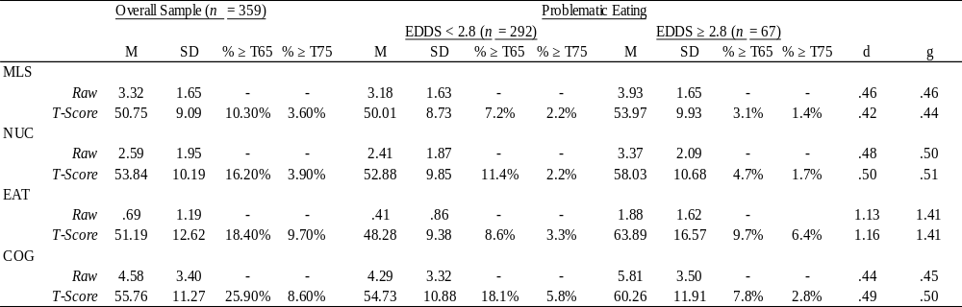
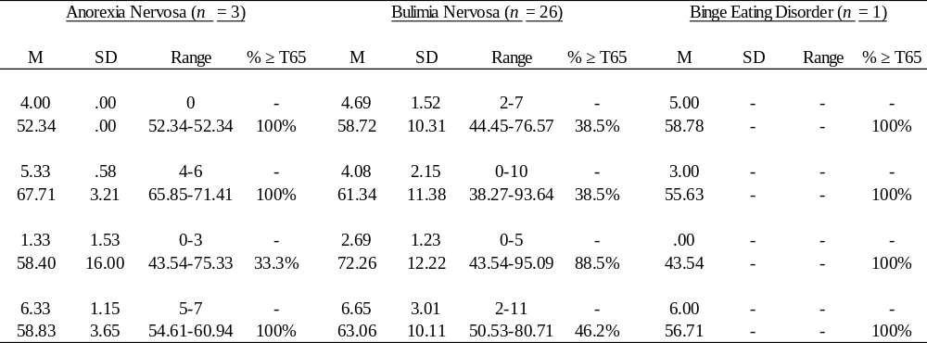
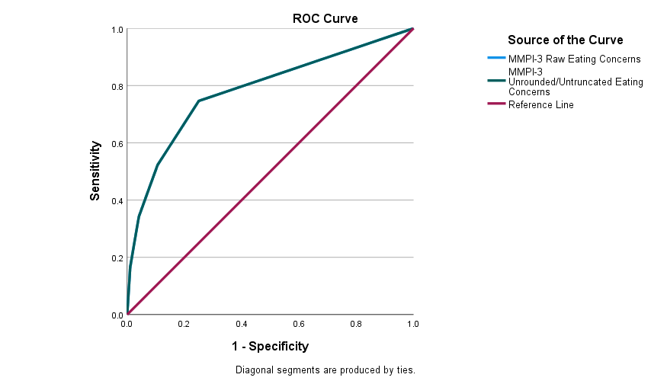
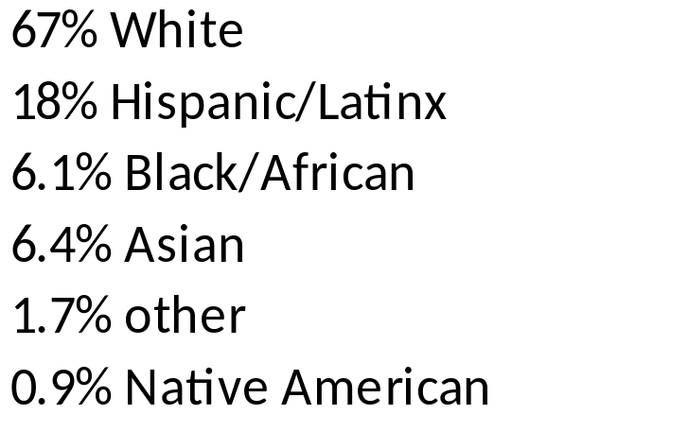

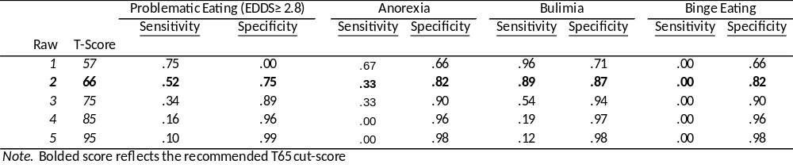
Classification Accuracy of the MMPI-3’s Eating Concerns (EAT) Scale using a Common Screening Measure as the Criterion
Ashlinn S. Peters¹, Nicole M. Morris¹ & Paul B. Ingram, PhD.^{1,2},
¹Department of Psychological Sciences, Texas Tech University, Lubbock, TX
Introduction
Results
Conclusions
RATIONALE
Between 3-14% of college students have an eating disorder
The EAT scale offers a novel measure of problematic eating on the MMPI-3 with initial research supporting its broad utility. None, to date, have examined diagnostic groups
Marek & Anderson (2021) examined thirty-eight postoperative bariatric patients and found clinical utility for EAT when assessing bariatric patients for problematic eating behaviors.
Vaňousová et al. (2021) examined the validity of the EAT scale in university students when compared to other validated eating disorder measures and found support for the EAT scale’s validity and ability to detect disordered eating behaviors amongst university students.
Morris et al (in review) examined college students and found support for the utility of EAT broadly detecting disordered eating behaviors (restricting, purging, and binging), and some differences in gender presentation
STUDY OBJECTIVE
This study examines the diagnostic utility of the MMPI-3 EAT scale for individuals who have screened positively eating disorders.
Group Means
Classification and Identification
The difference in mean scores between scales (g = .44 to 1.41; d = .44 to 1.16) were moderate to large
j
Limitations
Further classification and identification should be done on other populations as ours was limited to college students
Low sample size in the Anorexia Nervosa and Binge-eating disorder groups
FUTURE STUDY AND IMPLICATIONS
Results contradicting existing research on what class structures should be expected in those with mTBI:
>> No evidence of a Mania Group (Demakis et al.)
>> No evidence of an Externalizing Group (Demakis et al.)
>> No evidence of a Somatic Group (Demakis et al.)
The EAT scale has good discriminant validity when compared to other MMPI-3 measures as well as moderate construct validity compared to the EDDS
The EAT scale can be a good indicator of problematic disordered eating but other measures should be used for diagnostics of an eating disorder
Provides evidence for diagnostic utility of the EAT scale in the MMPI-3 to detect problematic eating behaviors
Area Under the Curve
Health Behaviors
Method
PARTICIPANTS
345 college students (70.4% female)
Ethnicity
19.97 years old (SD = 4.3)
Overall BMI 24.7 kg/m2 (SD= 5.2)
PROCEDURE
Participants were recruited utilizing college research pool (SONA), flyers, class credit purposes. Individually were also screened for problematic eating on the EDDS from the broader student body and reimbursed financially for their participation.
74 participants were excluded for invalid responding
We calculate classification accuracy for EAT across groups with positive and negative screenings for problematic eating, and for specific eating disorders. We also compute correlations for a validity investigation of these groups.
Point Estimate Classification
References available upon request

