Slide 1
Predictive Utility of Experimental Higher-Order Validity Scales for the MMPI-3
William H. Mentonª, Megan R. Whitman^{b}, Jessica L. Tylicki^{c}, Nicole M. Morris^{d}, Anthony M. Tarescavage^{e}, Paul B. Ingram^{d}, Roger O. Gervais^{f}, Dustin B. Wygant^{g}, Yossef S. Ben-Porath^{b}
^{A}Nystrom & Associates, ^{b}Kent State University, ^{c}Neurobehavioral Institute, ^{d}Texas Tech University, ^{e}Cleveland Psychological Testing, ^{f}Neurobehavioural Associates, Inc., ^{g}Eastern Kentucky University

Slide 2
Introduction
Project goal: create experimental scales representing higher-order response styles
  “OVR”: Over-reporting
  “UNR”: Under-reporting
Potential utility
  Organizing framework for conceptualizing and organizing validity scale findings
  Improved detection of invalid responding
Notes:
Extension of findings presented last year
Project goal…
Validity scales are substantially intercorrelated
This suggests higher-order factors representing general response styles
What if we were able to measure these more explicitly?
Organizing framework…
Analogous to higher-order substantive scales
Provide a “bird’s-eye view” of response style
Improved detection…
Possible that higher-order scales could be useful in their own right
By aggregating information from multiple validity scales, they might be able to identify invalid responding not otherwise detected

Slide 3
Previous Work
Menton and colleagues¹ presented on properties of aggregate over-reporting and under-reporting item pools of MMPI-2-RF²
  Over-reporting scale demonstrated competitive predictive validity
  Under-reporting scale demonstrated superior predictive validity
Menton and colleagues³ presented on replication and extension using MMPI-3⁴
  Refined item pools statistically
  Results mirrored those from MMPI-2-RF project
Notes:
MMPI-2-RF work
Aggregated all OR items into one scale, did same for UR items
Assessed validity in discriminating between known groups – simulators, PVT failers
Compared performance to standard validity scales
MMPI-3 work
Started similarly – aggregated all OR items into one scale and UR items into another
Used EFA, bifactor IRT, and DIF analysis to refine scales
Analyzed internal structure based on thousands of protocols collected across many settings during MMPI-3 development
For OR scale, eliminated items that appeared more strongly influenced by their substantive content than by common OR factor
For UR scale, items generally loaded onto a single factor
For both scales, eliminated items that evidenced DIF by race or gender
This resulted in several candidate scales for OR and UR; we retained one of each for further consideration here
All validation emphasized zero-order associations (AUC)

Slide 4
The Present Study
Primary goal: evaluate classification utility of higher-order validity scales
  Compare to standard validity scales
  Emphasize norm-referenced cut score
Secondary goal: assess incremental utility of scales
Candidate scales:
  OVR: 89 items (out of 115 over-reporting items)
  UNR: 25 items (out of 28 under-reporting items)

Slide 5
Participants
Undergraduate simulation sample 1 (n = 753)⁵ – Participants assigned to one of three instruction groups
  Standard (n = 288), feigned psychopathology (n = 250), under-reporting (n = 215)
Undergraduate simulation sample 2 (n = 560)⁶ – Participants assigned to one of two instruction groups
  Standard (n = 457), feigned PTSD (n = 103)
Forensic neuropsychology practice (n = 400)
  No PVT failure (n = 277), PVT failure (n = 123), PVT failure base rate = .31
Other field datasets
  Clinical neuropsychology (n = 259)
  Community mental health center (n = 791)
  Private practice mental health clinic (n = 596)
  Police-combined (n = 10,079)
Notes:
All over-reporting analyses excluded participants who invalidated based on inconsistent responding
Under-reporting analyses excluded all participants who invalidated based on standard criteria
Sim sample 1 collected during MMPI-3 development to evaluate updated validity scales
Sim sample 2 collected at separate university as part of different project; included other simulation groups not presented here
The police dataset consists of data collected from three different sites; the vast majority of these data come from police candidate evaluations (with a handful from FFD evaluations)

Slide 6
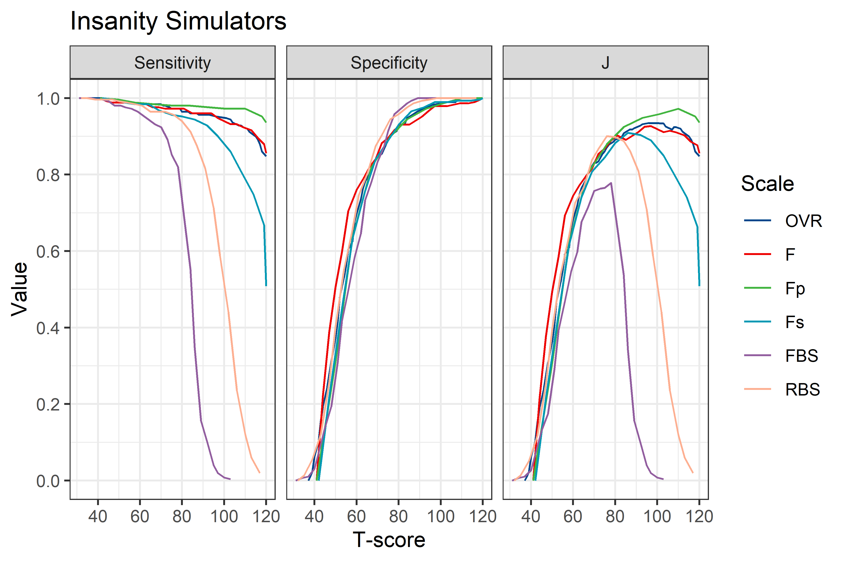
Notes:
These are classification utility statistics from the first simulation sample, which is described in a 2021 study by Whitman, Tylicki, and Ben-Porath
Some participants took the MMPI under standard instructions; others were told to pretend they had been charged with a very serious crime and wanted to feign a severe mental illness to avoid conviction or reduce their sentence
Thus, we are looking at how well these scales perform in discriminating between standard instruction and feigning groups
What we want to see is how well OVR compares to the standard validity scales
Orient to scales
Describe Youden’s J
All scales show similarly high specificity in discriminating between groups but vary wildly in sensitivity
F and Fp are strong in both Sen and Spc, with Fp performing best of all
OVR is very close to F, with a slightly higher overall combination of Sen and Spc at the usual cut point for protocol invalidity

Slide 7
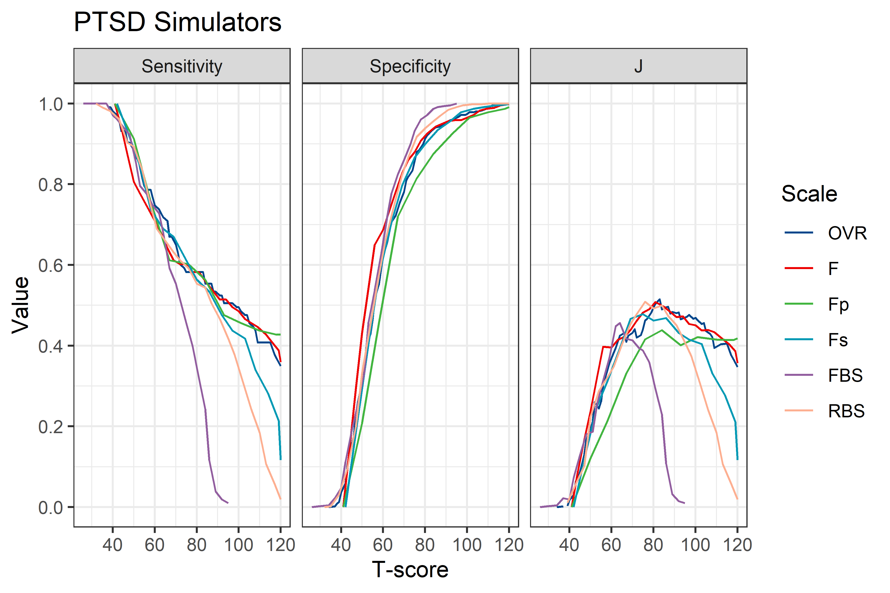
Notes:
This is a different simulation sample
Here, standard test takers are again contrasted with a feigning group
In this sample, feigners were provided coaching regarding the symptoms and diagnostic criteria associated with PTSD and asked to present themselves as if they had severe, debilitating PTSD
Sensitivity is substantially lower here for all scales relative to the previous study
Specificity is still somewhat high
Interestingly, Fp appears to have the lowest Spc in these analyses
The highest Sen and highest overall combination of Sen/Spc appears to be found in F and OVR, with a slight advantage for OVR

Slide 8
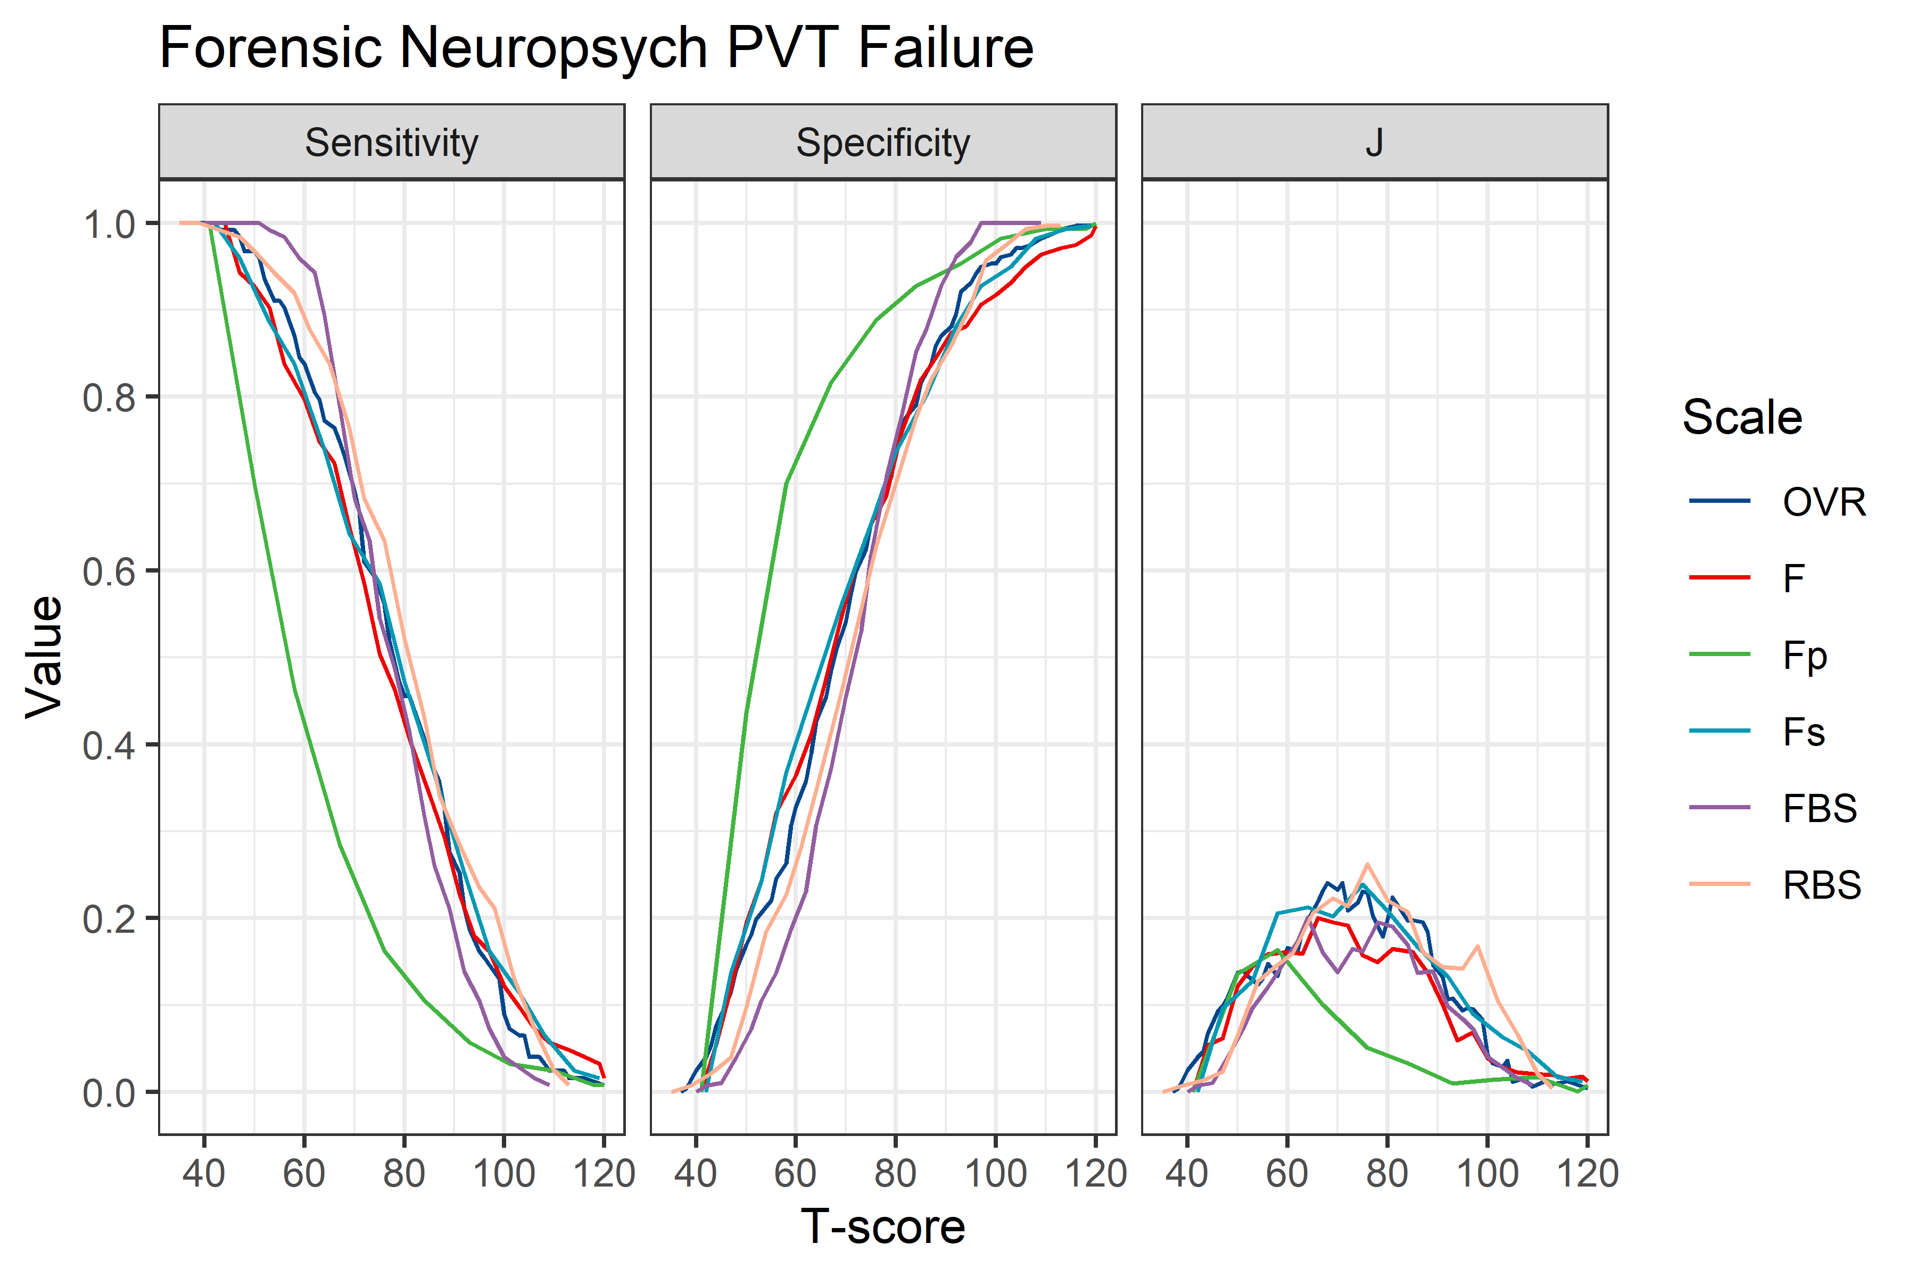
Notes:
This is not a simulation sample but is from a real-world forensic neuropsychology clinic in which evaluees are typically seeking benefits or compensation
These data come from the same setting in which the RBS scale was first developed for the MMPI-2-RF, but the present data of course do not include any of the same testing protocols
The criterion is PVT failure; we are looking at the scales’ ability to discriminate between individuals who have failed a PVT and those who have not
Perhaps unsurprisingly, the validity scales are generally less sensitive or specific to this criterion than to group membership in simulated psychopathology studies
Although Fp is more specific to PVT failure at lower elevations, its sensitivity is very low
The best overall combinations of Sen and Spc appear to belong to RBS, Fs, and OVR

Slide 9
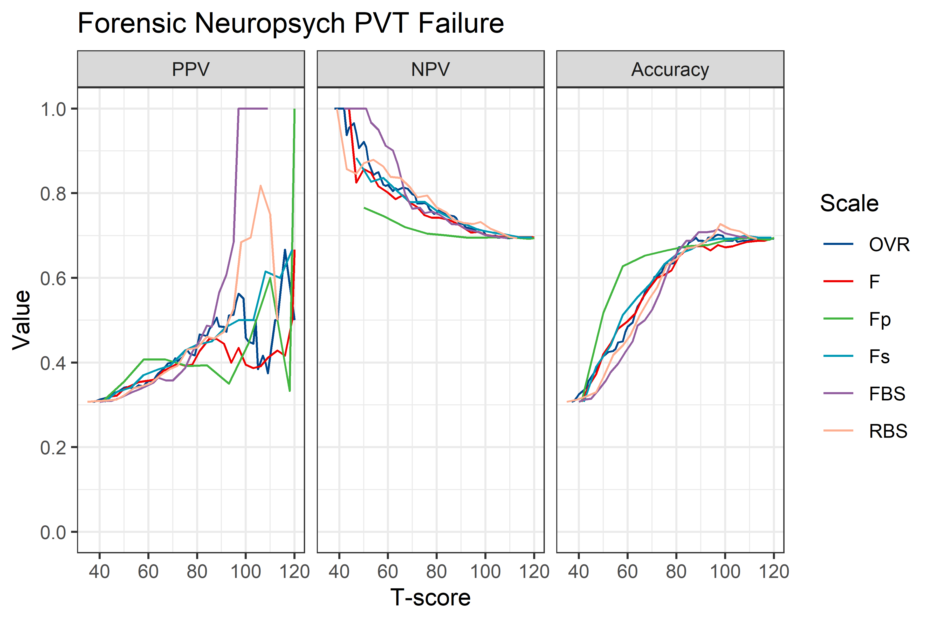
Notes:
Given that this is a real-world clinical setting, it may be informative to look at PPV, NPV, and Acc, which are more directly relevant to clinical decision-making
These curves are a bit messier
They show that FBS and RBS both have very strong PPV at high elevations, whereas most of the validity scales show similar NPV in that range
OVR tends to show middle-of-the-road performance here, tending to fall second or third in rank in the upper interpretive ranges after FBS and RBS
It is more difficult to parse apart their relative performance in overall Acc
RBS shows the highest overall Acc, then FBS, then OVR
One point to make, having reviewed these three datasets, is that OVR is only occasionally the strongest group differentiator; however, it is consistently among the strongest, even though the individual standard validity scales vary substantially in relative performance, depending on the prediction task
This suggests that OVR is indeed picking up on a higher-order OR style that is relatively robust across settings

Slide 10
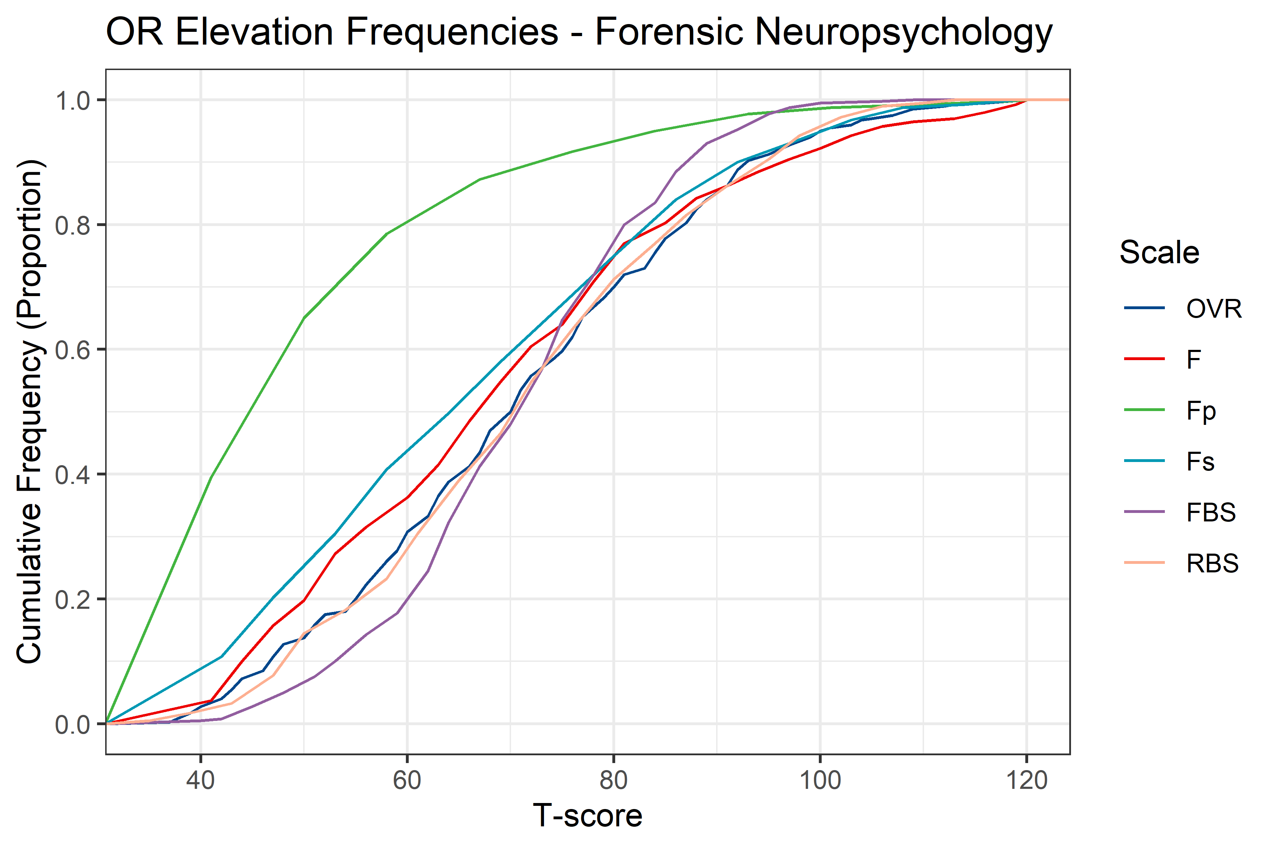
Notes:
This is a different kind of plot
These curves show the elevation rates of the different over-reporting scales in the forensic neuropsych data
These data have nothing to do with PVT failure, they only reflect the scale elevation rates in the overall sample
Curves that are farther to the right indicate that higher scores are more common for that scale
These are cumulative proportions; for example, these data show that about 80% of the sample has a T-score of 60 or below on Fp
If we were to consider using OVR as an additional exclusion criterion for protocol invalidity at a T-score of 100, as with F or Fp, we would want the elevation rate for OVR to be similar to F or Fp at that T-score
We do find that to be the case in this setting; OVR is somewhere between F and Fp at a T-score of 100, so the selection ratio would be similar

Slide 11
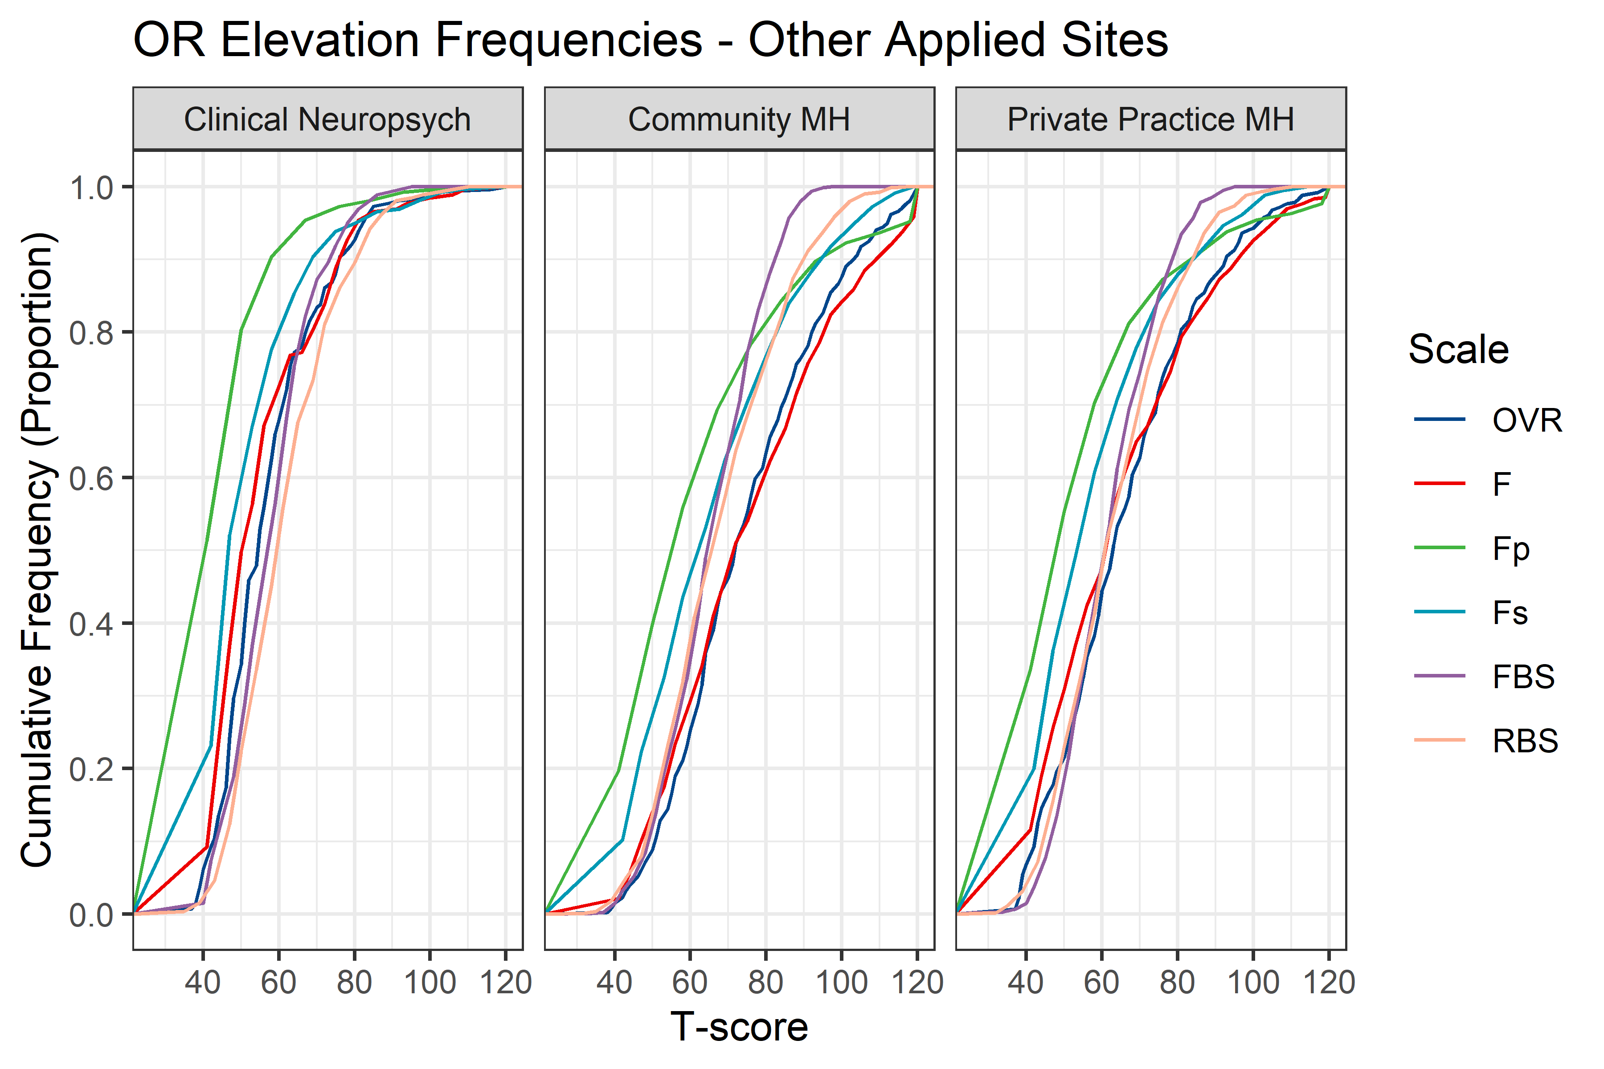
Notes:
We can assess this in other field data sites as well
These are some other field datasets that were collected during MMPI-3 development
In each case, we find OVR’s elevation rates at the target T-score of 100 to fall within the boundaries established by F and Fp

Slide 12
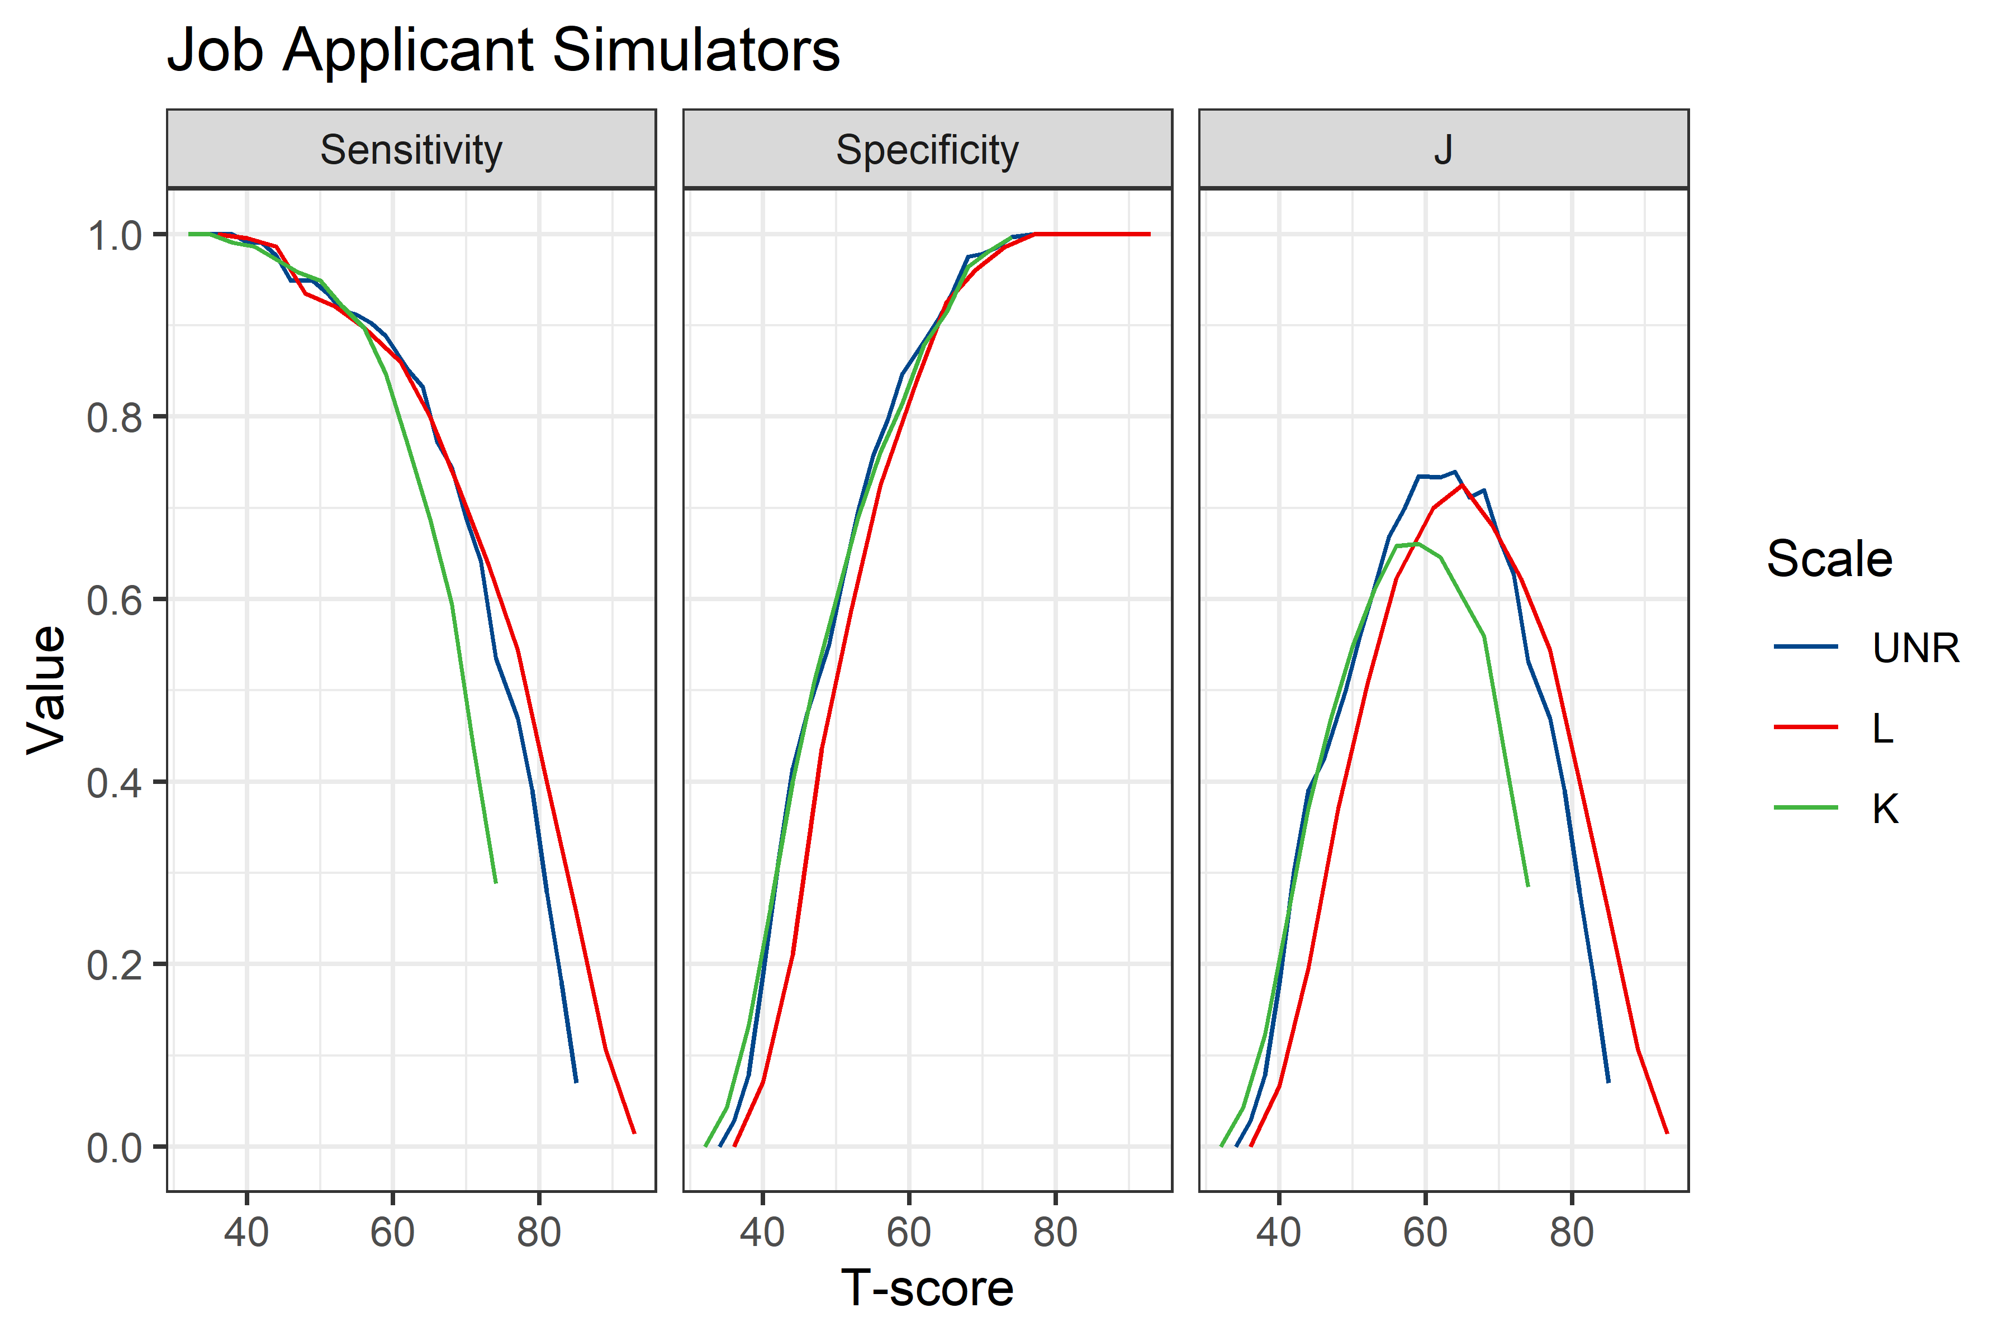
Notes:
Now let’s turn to the functioning of the higher-order under-reporting scale
These data come from the first simulation group discussed earlier
Here, we are contrasting test takers with standard instructions from those who had been instructed to under-report
The UR group received instructions to appear well-adjusted and morally virtuous, as if they were taking the test as part of an application for a highly desirable job
[Orient to scales]
We find that UNR and L are most sensitive to detecting group membership at higher elevations, whereas all three scales are similarly specific
The optimal combination of Sen and Spc is obtained by UNR around a T-score of 60 to 70, with L demonstrating a more optimal combination at higher elevations

Slide 13
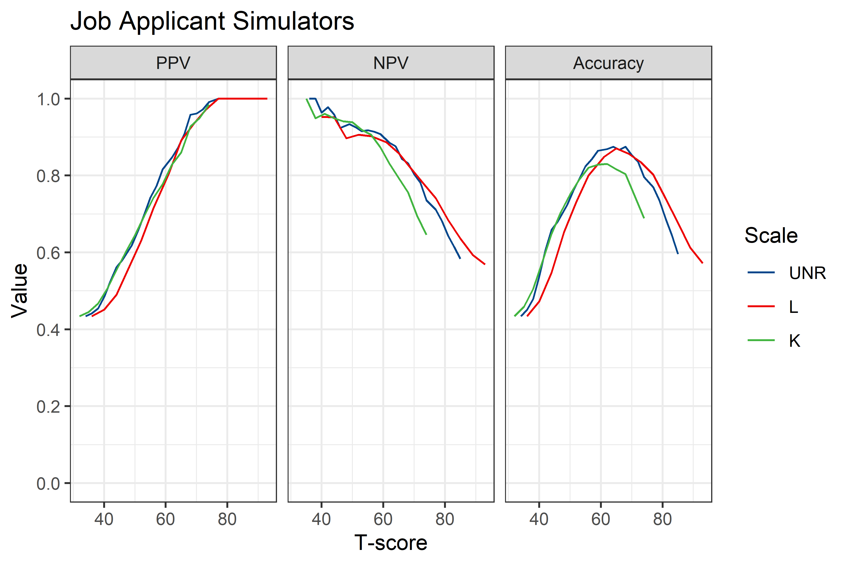
Notes:
PPV, NPV, and Acc provide additional information about these scales’ functioning in this sample
Although perhaps not dramatic, we do see evidence of superior PPV for UNR at moderate score elevations, with NPV similar or close to L
Overall, the groups are most optimally separated by UNR score

Slide 14
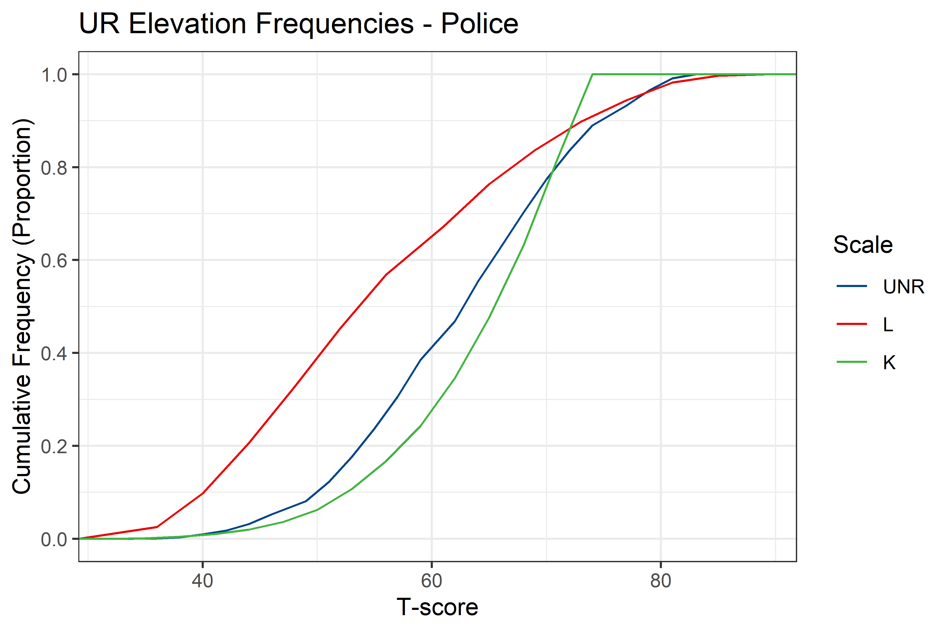
Notes:
These are cumulative elevation rates for the UR scales in a very large sample of data taken from police evaluations, primarily pre-employment
As we see here, L and K elevations are relatively common in these data
UNR shows comparable elevation rates in the standard interpretable range of 60 and up

Slide 15
Incremental Elevation Rates
 | T ≥ 70 | T ≥ 75 | T ≥ 80 | T ≥ 85 | T ≥ 90 | T ≥ 95 | T ≥ 100
CRIN vs. VRIN/TRIN | .05 | .09 | .12 | - | - | - | -
OVR vs. F/Fp
UNR vs. L/K
Notes:
The analyses thus far do seem to show that the higher-order scales are capturing invalid responding to some meaningful extent
One other way to think about possible added value for these scales is to evaluate the extent to which they identify invalid responding that the other scales may have “missed”
As an analogy, consider CRIN, which is essentially a higher-order scale for measuring inconsistent responding – it is scored by adding together VRIN and TRIN
In some cases, CRIN may invalidate a protocol even when VRIN and TRIN both fall below that cutoff, because the combined information from those scales reveals something about the test taker’s response style that was not fully captured in either of the scales individually
These data show the rate at which the higher-order validity scale identifies an elevation at the given level when the identified lower-order validity scales do not
For these analyses, we used a combination of many different MMPI-3 field data sets, including, but not limited to the ones already discussed
Example interpretation: for every 100 test takers who reach a T-score of 80 on VRIN or TRIN, another 12 will reach a T-score of 80 on CRIN without hitting that threshold on VRIN or TRIN
These data show that the experimental higher-order scales demonstrate some modest incremental utility in identifying significant levels of invalid responding
A small number of test takers could invalidate the test based on OVR but not on F or Fp
UNR identifies quite a few otherwise undetected potential under-reporters in the 70-80 range, but by the time UNR reaches 80 virtually all test takers have also reached a score of 80 on L

Slide 16
Incremental Elevation Rates
 | T ≥ 70 | T ≥ 75 | T ≥ 80 | T ≥ 85 | T ≥ 90 | T ≥ 95 | T ≥ 100
CRIN vs. VRIN/TRIN | .05 | .09 | .12 | - | - | - | -
OVR vs. F/Fp | .11 | .06 | .06 | .03 | .03 | .05 | .02
UNR vs. L/K
Notes:
The analyses thus far do seem to show that the higher-order scales are capturing invalid responding to some meaningful extent
One other way to think about possible added value for these scales is to evaluate the extent to which they identify invalid responding that the other scales may have “missed”
As an analogy, consider CRIN, which is essentially a higher-order scale for measuring inconsistent responding – it is scored by adding together VRIN and TRIN
In some cases, CRIN may invalidate a protocol even when VRIN and TRIN both fall below that cutoff, because the combined information from those scales reveals something about the test taker’s response style that was not fully captured in either of the scales individually
These data show the rate at which the higher-order validity scale identifies an elevation at the given level when the identified lower-order validity scales do not
For these analyses, we used a combination of many different MMPI-3 field data sets, including, but not limited to the ones already discussed
Example interpretation: for every 100 test takers who reach a T-score of 80 on VRIN or TRIN, another 12 will reach a T-score of 80 on CRIN without hitting that threshold on VRIN or TRIN
These data show that the experimental higher-order scales demonstrate some modest incremental utility in identifying significant levels of invalid responding
A small number of test takers could invalidate the test based on OVR but not on F or Fp
UNR identifies quite a few otherwise undetected potential under-reporters in the 70-80 range, but by the time UNR reaches 80 virtually all test takers have also reached a score of 80 on L

Slide 17
Incremental Elevation Rates
 | T ≥ 70 | T ≥ 75 | T ≥ 80 | T ≥ 85 | T ≥ 90 | T ≥ 95 | T ≥ 100
CRIN vs. VRIN/TRIN | .05 | .09 | .12 | - | - | - | -
OVR vs. F/Fp | .11 | .06 | .06 | .03 | .03 | .05 | .02
UNR vs. L/K | .08 | .19 | .00 | - | - | - | -
Notes:
The analyses thus far do seem to show that the higher-order scales are capturing invalid responding to some meaningful extent
One other way to think about possible added value for these scales is to evaluate the extent to which they identify invalid responding that the other scales may have “missed”
As an analogy, consider CRIN, which is essentially a higher-order scale for measuring inconsistent responding – it is scored by adding together VRIN and TRIN
In some cases, CRIN may invalidate a protocol even when VRIN and TRIN both fall below that cutoff, because the combined information from those scales reveals something about the test taker’s response style that was not fully captured in either of the scales individually
These data show the rate at which the higher-order validity scale identifies an elevation at the given level when the identified lower-order validity scales do not
For these analyses, we used a combination of many different MMPI-3 field data sets, including, but not limited to the ones already discussed
Example interpretation: for every 100 test takers who reach a T-score of 80 on VRIN or TRIN, another 12 will reach a T-score of 80 on CRIN without hitting that threshold on VRIN or TRIN
These data show that the experimental higher-order scales demonstrate some modest incremental utility in identifying significant levels of invalid responding
A small number of test takers could invalidate the test based on OVR but not on F or Fp
UNR identifies quite a few otherwise undetected potential under-reporters in the 70-80 range, but by the time UNR reaches 80 virtually all test takers have also reached a score of 80 on L

Slide 18
Discussion: OVR
Sensitive and specific to over-reporting under a range of context demands
Potential utility as additional protocol invalidation criterion alongside F and Fp
  Comparable elevation rates to F and Fp
  Identifies some cases not identified by F or Fp
Notes:
Appears to capture a reasonably robust over-reporting response style
Not necessarily the strongest identifier of over-reporting in any single context but generally a good one
Relative performance more stable than other scales across testing contexts

Slide 19
Discussion: UNR
Appears to meaningfully add to detection of under-reporting
Greatest advantage at low to moderate elevation rates
Little apparent advantage at very high elevations (i.e., ≥ 80T)
Notes:
Preliminary evidence base smaller than for OVR – fewer validation criteria available

Slide 20
References
¹Menton, W. H., Crighton, A. H., Ben-Porath, Y. S., Burchett, D. L., Dragon, W. R., & Gervais, R. O. (2016, March). Exploring the Feasibility of Higher-Order Validity Scales in the MMPI-2-RF. Paper presented at the meeting of the Society for Personality Assessment, Chicago, IL.
²Ben-Porath, Y. S., & Tellegen, A. (2008/2011). MMPI-2-RF: Manual for administration, scoring and interpretation. Minneapolis: University of Minnesota Press.
³Menton, W. H., Whitman, M. R., Hansen, A., Tylicki, J., Tarescavage, A. M., Gervais, R. O., Wygant, D. B., Ben-Porath, Y.S. (2021, June). Exploring the Feasibility of Higher-Order Over- and Under-Reporting Scales for the MMPI-3. Paper presented at the Annual MMPI Research Symposium, Minneapolis, MN.
⁴Ben-Porath, Y. S., & Tellegen, A. (2020a). MMPI-3 Manual for administration, scoring, and interpretation. Minneapolis, MN: University of Minnesota Press.
⁵Whitman, M. R., Tylicki, J. L., & Ben-Porath, Y. S. (2021). Utility of the MMPI-3 validity scales for detecting overreporting and underreporting and their effects on substantive scale validity: A simulation study. Psychological Assessment.
⁶Morris, N. M., Mattera, J., Golden, B., Moses, S., & Ingram, P. B. (2021). Evaluating the performance of the MMPI-3 over-reporting scales: sophisticated simulators and the effects of comorbid conditions. The Clinical Neuropsychologist, 1-9.

Slide 21

Questions?
bmenton@gmail.com

Slide 22
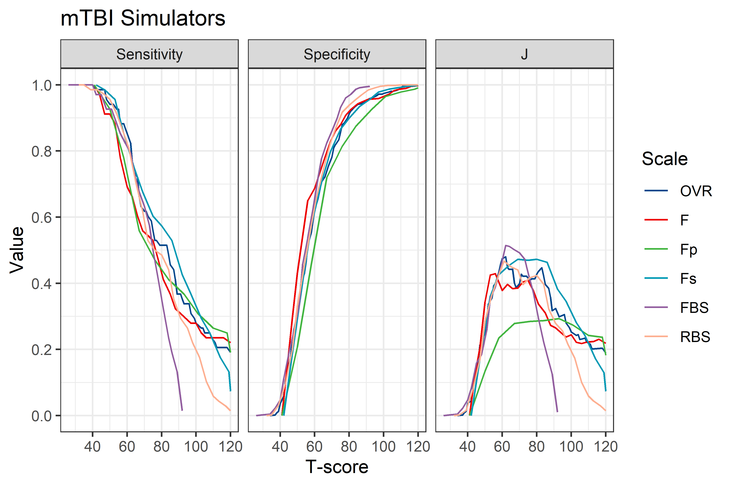

Slide 23
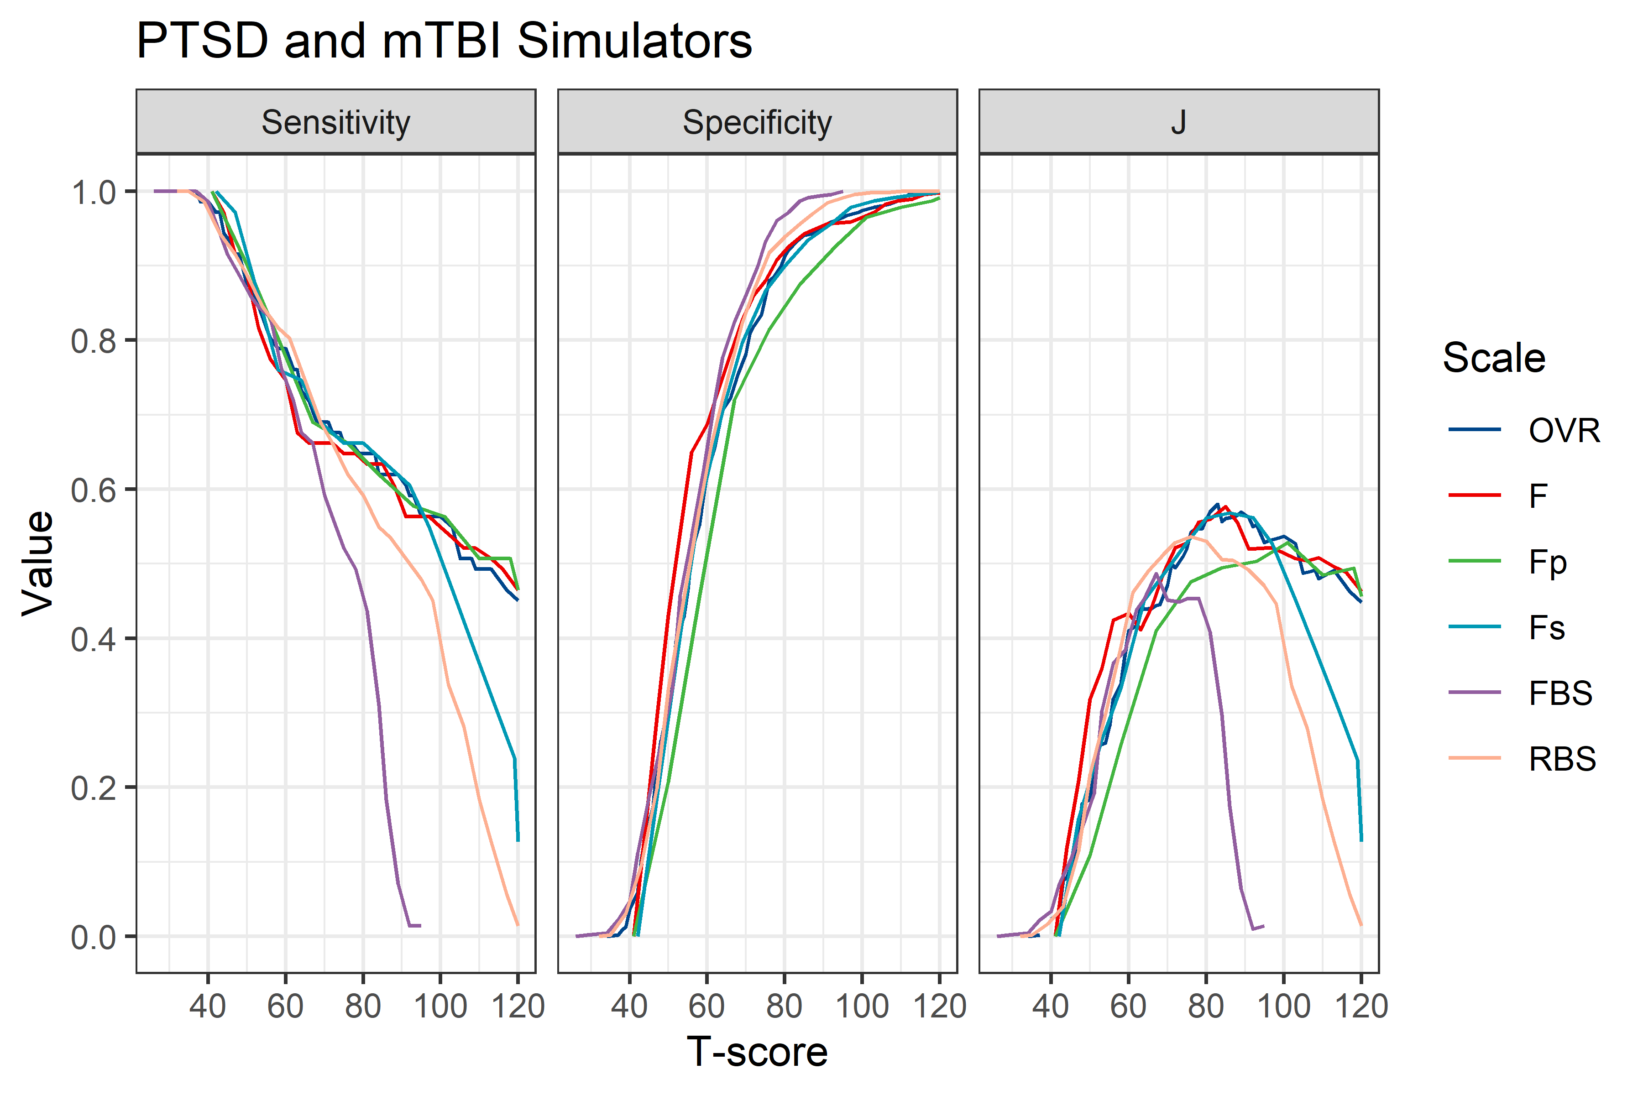

Slide 24
