Slide 1


Using the MMPI-3 to predict treatment engagement and outcomes in a community telehealth clinic using a positive psychology treatment protocol
Brian Cole
Paul Ingram

Slide 2

Agenda
I. Positive Psychology Intervention
II. Data Collected
III. Preliminary and Proposed Analysis
IV. The next 18 months

Slide 3
Study Goals
Identify specific mechanisms of improvement using a Strength-based Treatment approach
Link the MMPI-3 with prediction of baseline functioning and symptom/functional improvement
Link the MMPI-3 with treatment engagement behaviors and therapeutic alliance

Slide 4
Study Goals
Identify specific mechanisms of improvement using a Strength-based Treatment approach
Link the MMPI-3 with prediction of baseline functioning and symptom/functional improvement
Link the MMPI-3 with treatment engagement behaviors and therapeutic alliance

Slide 5
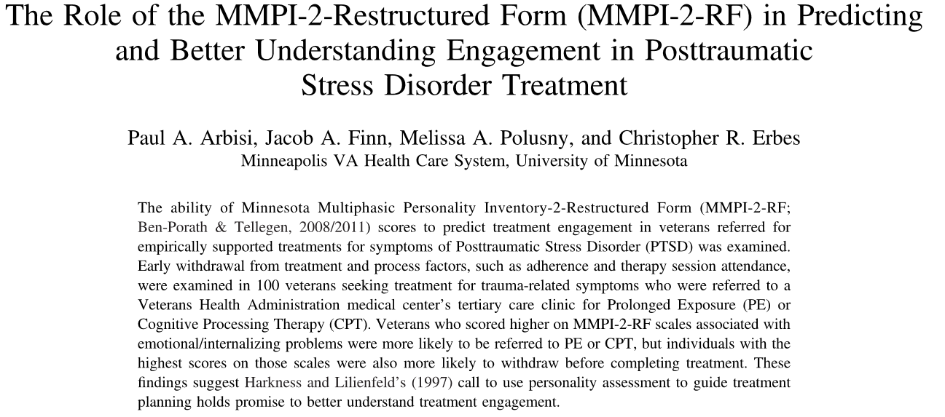
I. Intervention
Limited research exists on outcome prediction with the MMPI
MMPI Treatment research has used deficit models of model health as their primary outcomes
Similarly, treatment research prioritizes these models; however, there are other approaches

Slide 6
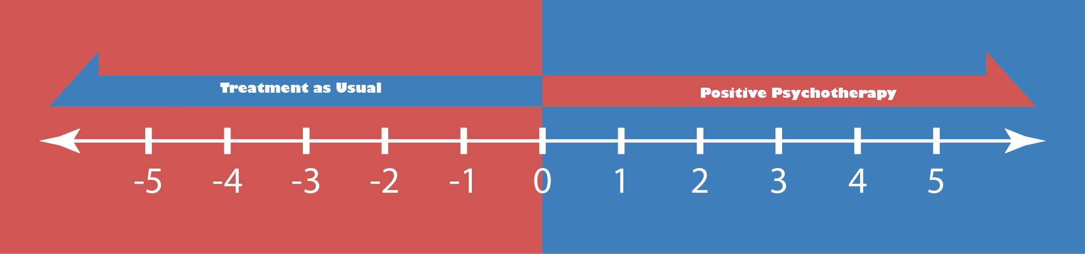
I. Intervention

Slide 7

How Does Increased Well-Being Help?
If your problem is this size
And your resources are this size…
Problem
Well-being
Then your ability to deal with the problem is more challenging than if…

Slide 8
How Does Increased Well-Being Help?
If the problem is this size
And your resources are this size…
Well-being
Problem
Notes:
the linear causal link between problem and treatment is not fit with psychology (more physical science/ medical model)
In our approach, we do not ignore the problem; know the problem well enough to know when it is gone;
Know your strengths; Know how you best grow; Know your values / What is meaningful & enjoyable to you
Outgrow the problem through approach goals, positive emotions, strengths, and hope

Slide 9
I. Intervention
Session | Content
1 | Client Goal Setting
2 | Education on Positive Ψ
3 | Education on Hope Theory
4 | Strengths as a Pathway
5 | Strengths as a Pathway
6 | Agency Promotion
7 | Problems with Pathways
8 | Problems with Agency
9 | Future Problem Solving
10 | Celebration of Successes

Slide 10
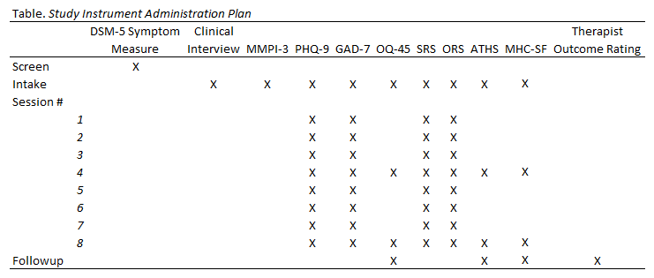
II. Data Collected

Slide 11
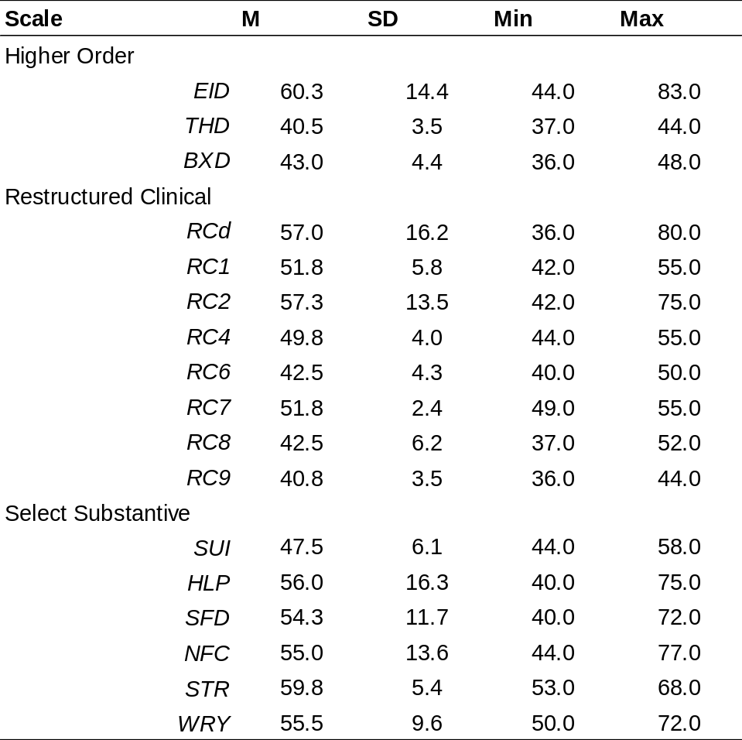
IIIa. Preliminary Analyses
Data Gathered from Intake Assessments

Slide 12
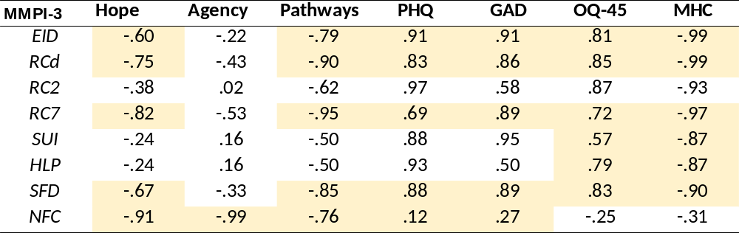
IIIa. Preliminary Analyses
Data Gathered from Intake Assessments

Slide 13
IIIb. Proposed Analyses
We Anticipate Goal Setting, Goal Attempts, and Perceptions of Goal Success will be predicted by the MMPI-3, as similar rates to symptom levels
Session | Content
1 | Client Goal Setting
2 | Education on Positive Ψ
3 | Education on Hope Theory
4 | Strengths as a Pathway
5 | Strengths as a Pathway
6 | Agency Promotion
7 | Problems with Pathways
8 | Problems with Agency
9 | Future Problem Solving
10 | Celebration of Successes

Slide 14
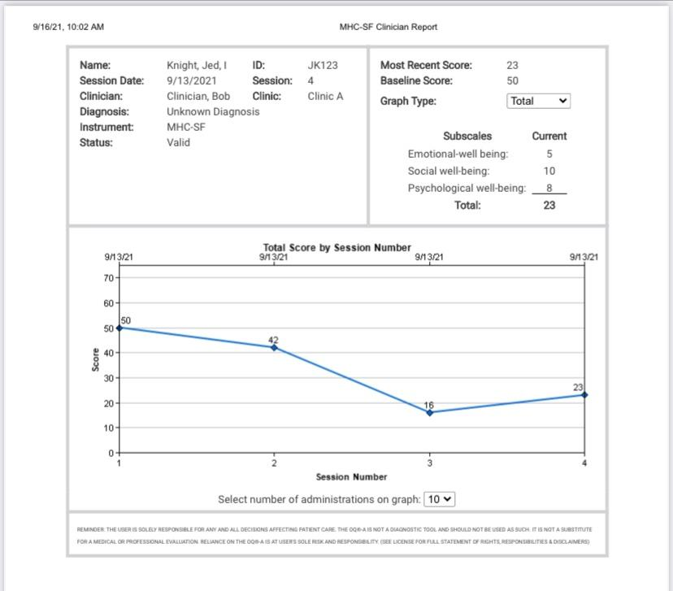
Case Example

Slide 15
IV. Revised Timeline
May 22’
First Year feasibility trial ends
Problem Solving for Measure Administration Issues
Expanded Recruitment Base
June 22’
2nd Wave of summer data collection Starts
16 clinicians, up to 4 clients each at a time during each of two summer semesters
n = 89 pre-screened and started June 1st
December 22’
2nd Wave (Fall) of Data collection concludes
Anticipated 90 clients
May 23’
2nd Wave Completed
Total Recruitment Anticipated = 250
December 23’
Initial Manuscripts Submitted

