Slide 1


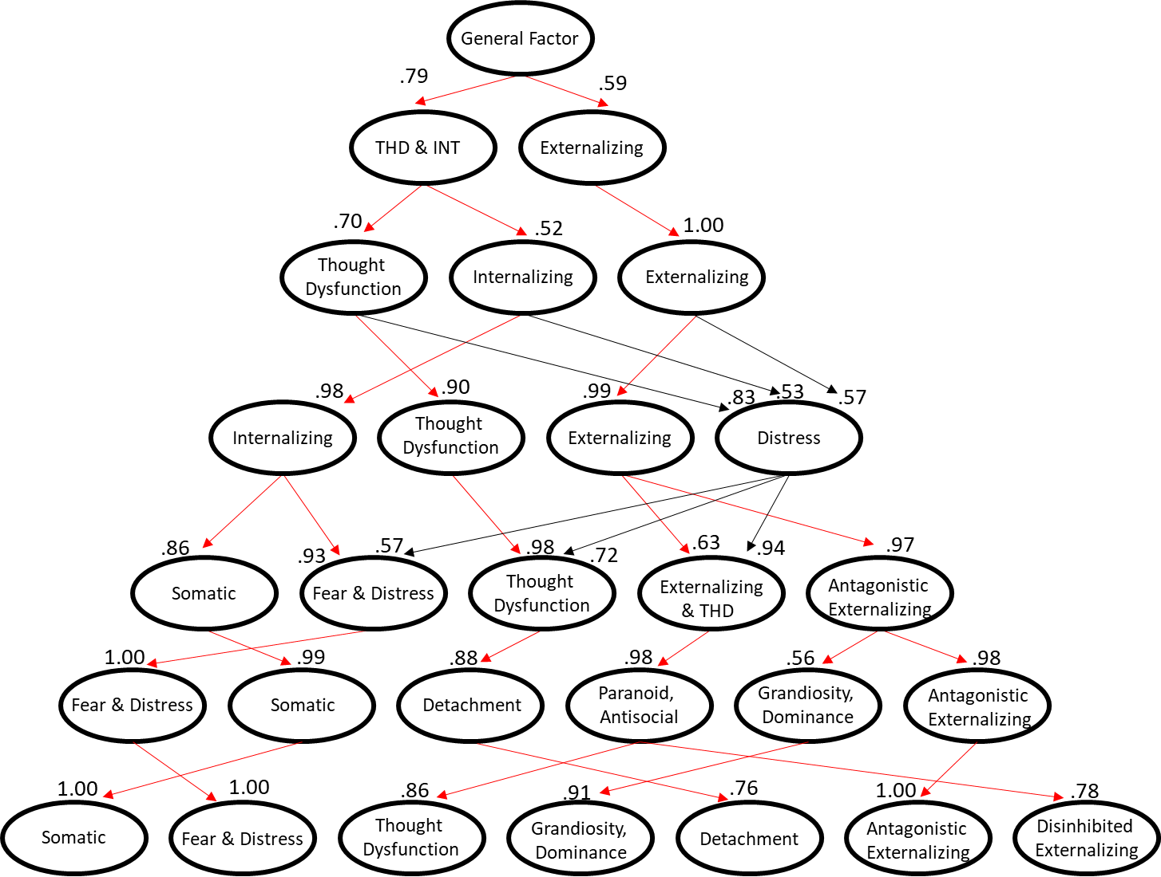
Mapping the Personality Assessment Inventory (PAI) onto the HiTOP model
of psychopathology: Exploratory Factor Analysis in Active-Duty Military
Keen, M.A., Hirsch, S., Ingram, P.B., & Armistead-Jehle, P.
Department of Psychological Sciences, Texas Tech University
Introduction
Bass-ackwards EFA Factor Model
Results
RATIONALE
The Hierarchical Taxonomy of Psychopathology (HiTOP; Kotov et al., 2017) is a contemporary, dimensional model of psychopathology
HiTOP includes a hierarchy of Somatoform, Internalizing, Thought Disorder, Detachment, and Externalizing spectra with related subfactors & syndromes (Kotov et al., 2021).
Assessing these spectra is constrained to the degree that broadband measures capture hierarchical pathology in this way.
The Personality Assessment Inventory (PAI) has yet to be mapped onto this model despite its wide use and promise (Jankowsky et al., 2021; Morey, 2014).
STUDY OBJECTIVE
This study maps the PAI onto a contemporary interpretive framework (HiTOP) using EFA
Bass-ackwards analyses suggested that scale content generally broke down into hierarchical levels consistent with HiTOP dimensions
  Factors 1-4
  Three major HiTOP spectra emerged consistently
  Internalizing & Thought Disorder dimensions were especially inter-related
  A 4th distress/demoralization factor was evident
  Factors 5-7
  Consistent with HiTOP sub-spectra
  Excessive intercorrelations between structure levels, possibly due to demoralization saturating clinical scale item content
Extracted 1-9 factors, with the solutions for up to 7 factors presented here
Factor solutions were evaluated on the basis of model fit and theoretical cohesiveness
The 7-factor solution provided the best fit
  Χ² (399) = 771.87
  RMSEA = .055 [95% CI = .049 to .061], p < .05
  CFI = .949
  SRMR = .025
  Smallest BIC value
Findings surrounding the PAI’s structure and its utility for assessing HiTOP should be replicated in other clinical settings
Further validation of these factors with external criteria and their approximation to HiTOP dimensions are needed
Future research should investigate if extracting distress/demoralization from the PAI clinical scales reduces factor inter-correlations & improves the stability of these scale’s hierarchical structure
Hierarchic structure was consistent with HiTOP but excessively inter-correlated
Method
PARTICIPANTS
Final sample: 307 Active-Duty soldiers
84% male (n = 259)
70% white (n = 214)
Age: M = 38 years old (SD = 8.13)
PROCEDURE
Soldiers were administered the PAI as part of an evaluation in a neuropsychology clinic at a U.S. Army Health Center.
ANALYSES
EFA using Bass-ackwards procedures were used to investigate the hierarchical structure of PAI scale content (Goldberg, 2006)
Goemin Rotation & Maximum Likelihood Extraction
CRITERION MEASURES
Included all conceptually relevant and non-redundant PAI Scales
Clinical scales: ALC, DRG
Clinical sub-scales: all facets of clinical scales were included (e.g., the Anxiety Related Disorders clinical scale breaks down into Obsessive-Compulsive, Phobias, and Traumatic Stress sub-scales)
Interpersonal Scales: DOM, WRM
Treatment scales: AGG, STR
Note. Red lines reflect those expected based on Hi-Top. Black lines are factor correlations exceeding .50 which were not anticipated.
7-Factor solution provided the best fit & reflected most HiTOP sub-factors
Standardized Factor Loadings from 7-Factor Model
SOM-H | (.83)
SOM-S | (.78)
SOM-C | (.77)
DEP-P | (.46)
ANX-C | (.87)
ANX-A | (.75)
ANX-P | (.70)
ARD-P | (.58)
ARD-O | (.56)
SCZ-T | (.45)
BOR-I | (.37)
ARD-T | (.34)
PAR-P | (.90)
PAR-R | (.78)
BOR-N | (.67)
PAR-H | (.53)
SCZ-P | (.40)
STR | (.38)
DEP-C | (.37)
MAN-G | (.55)
DOM | (.51)
MAN-I | (.41)
WRM | (-.85)
SCZ-S | (.79)
AGG-A | (.92)
AGG-P | (.71)
AGG-V | (.67)
BOR-A | (.60)
BOR-S | (.61)
ANT-A | (.40)
ANT-S | (.64)
ANT-E | (.51)
ALC | (.37)
MAN-A | (.44)
Conclusions
Point-Biserial Correlations Between Factor Scores & Participant Diagnosis
Factors | PTSD | Depression | Comorbid PTSD & Depression | Substance Use | Adjustment Disorders | None | ADHD
Somatic | .12 | .11 | .38 | -.01 | -.11 | -.36 | -.17
Fear/Distress | .26 | .18 | .35 | -.05 | .01 | -.55 | -.08
Thought Dysfunction | .22 | .23 | .34 | -.04 | .01 | -.44 | -.06
Grandiosity/Dominance | -.01 | -.22 | .01 | .16 | -.03 | .01 | -.03
Detachment | .05 | .21 | .21 | -.01 | -.01 | -.20 | .05
Antagonistic Ext | .23 | .05 | .13 | -.02 | .07 | -.30 | -.13
Disinhibited Ext | .12 | .03 | .05 | .06 | .17 | -.22 | -.01
Author Note: References available upon request from Sarah Hirsch: mekeen@ttu.edu

