Slide 1



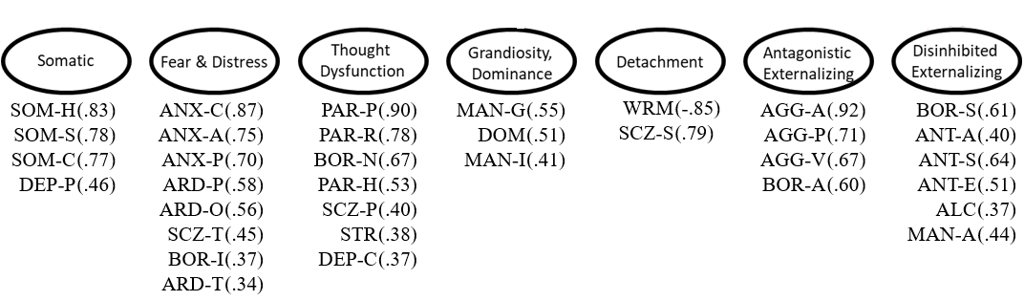
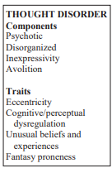
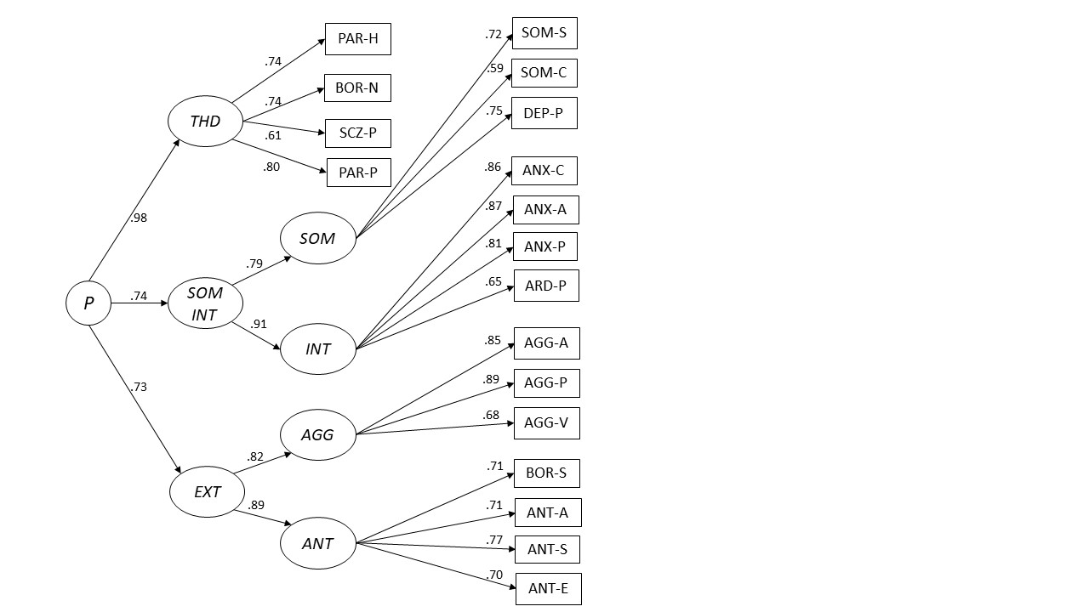
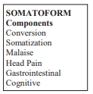
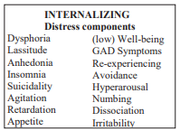
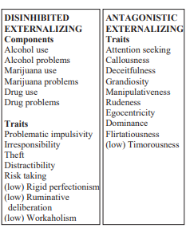
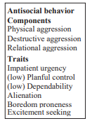
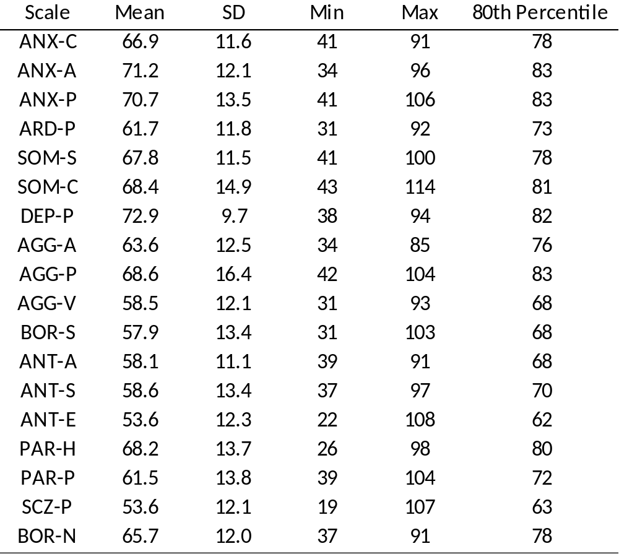
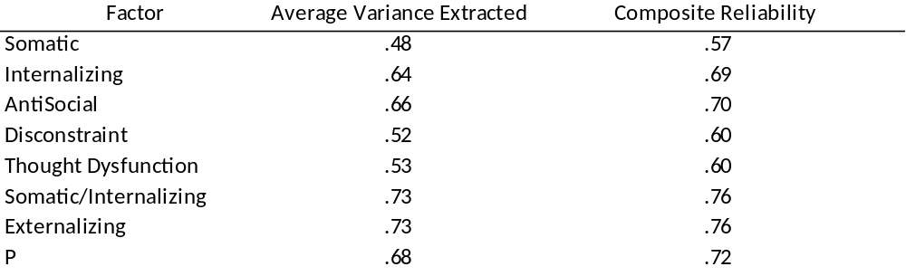

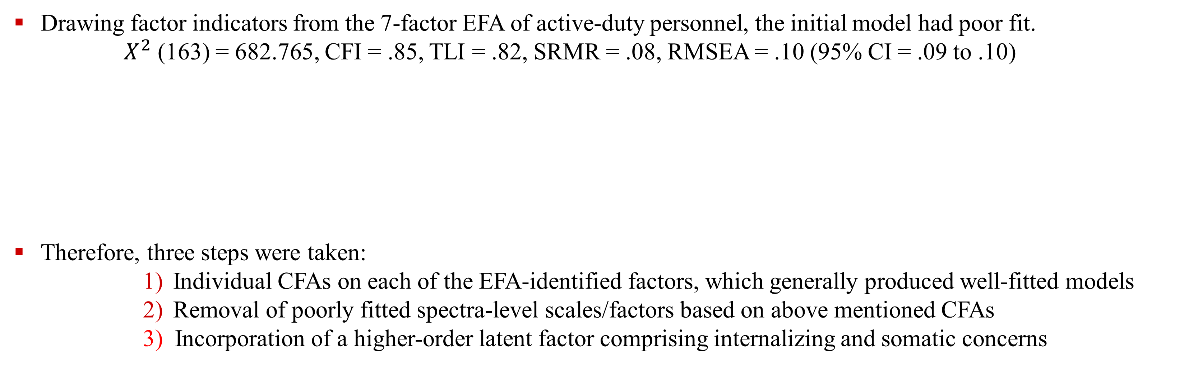
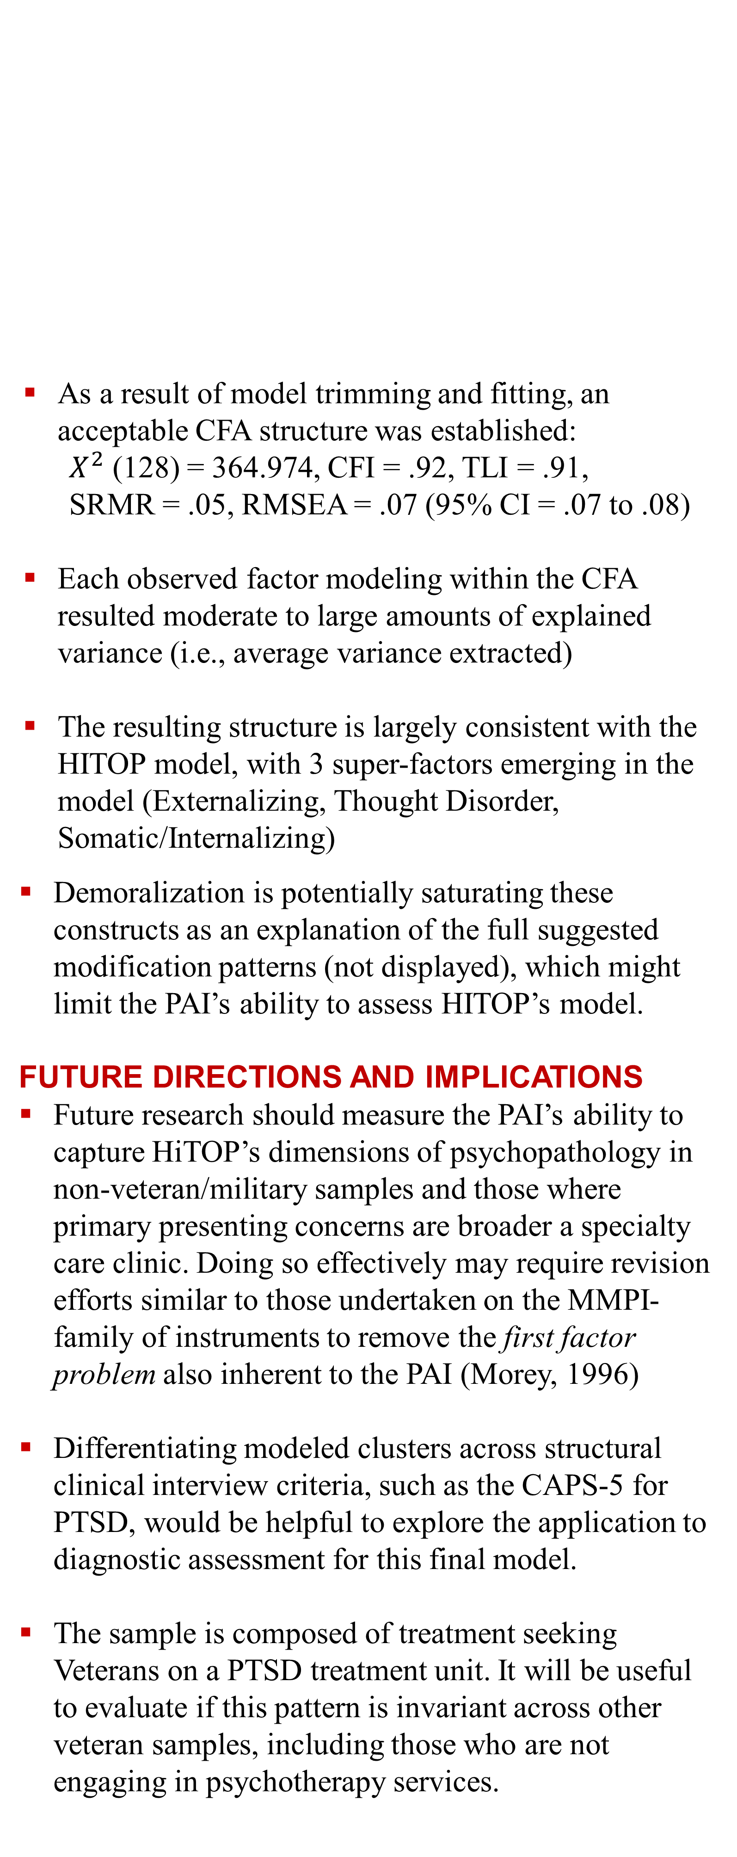
Mapping the Personality Assessment Inventory (PAI)
onto the Hi-Top model of psychopathology:
Confirmatory Factor Analysis using treatment seeking Veterans at Veteran Affairs
Hirsch, S., Keen, M. A., Ingram, P. B., & Sharpnack, J.
Department of Psychological Sciences, Texas Tech University
Ingramlab.wordpress.com
sarah.hirsch@ttu.edu
Introduction
Results
Conclusions
RATIONALE
The Hierarchical Taxonomy of Psychopathology (HiTOP; Kotov et al., 2017) is popular contemporary model of psychopathology that relies on a dimensional approach to model symptom presentation patterns
While some research has delved into bridging HiTop with existing broadband measures, no published work has mapped this model onto the Personality Assessment Inventory (PAI)
We conducted an EFA that found a 7-factor model had evidence of the best fit, consistent with the HiTOP model (Keen et al., 2022)
STUDY OBJECTIVE
Extend prior analyses on the PAI as a hierarchical personality measure by incorporating the EFA factor structure into a CFA analysis
As a result of model trimming and fitting, an acceptable CFA structure was established:
$X^{2}$ (128) = 364.974, CFI = .92, TLI = .91,
SRMR = .05, RMSEA = .07 (95% CI = .07 to .08)
Each observed factor modeling within the CFA resulted moderate to large amounts of explained variance (i.e., average variance extracted)
The resulting structure is largely consistent with the HITOP model, with 3 super-factors emerging in the model (Externalizing, Thought Disorder, Somatic/Internalizing)
Demoralization is potentially saturating these constructs as an explanation of the full suggested modification patterns (not displayed), which might limit the PAI’s ability to assess HITOP’s model.
FUTURE DIRECTIONS AND IMPLICATIONS
Future research should measure the PAI’s ability to capture HiTOP’s dimensions of psychopathology in non-veteran/military samples and those where primary presenting concerns are broader a specialty care clinic. Doing so effectively may require revision efforts similar to those undertaken on the MMPI-family of instruments to remove the first factor problem also inherent to the PAI (Morey, 1996)
Differentiating modeled clusters across structural clinical interview criteria, such as the CAPS-5 for PTSD, would be helpful to explore the application to diagnostic assessment for this final model.
The sample is composed of treatment seeking Veterans on a PTSD treatment unit. It will be useful to evaluate if this pattern is invariant across other veteran samples, including those who are not engaging in psychotherapy services.
Drawing factor indicators from the 7-factor EFA of active-duty personnel, the initial model had poor fit.
$X^{2}$ (163) = 682.765, CFI = .85, TLI = .82, SRMR = .08, RMSEA = .10 (95% CI = .09 to .10)
Therefore, three steps were taken:
  Individual CFAs on each of the EFA-identified factors, which generally produced well-fitted models
  Removal of poorly fitted spectra-level scales/factors based on above mentioned CFAs
  3) Incorporation of a higher-order latent factor comprising internalizing and somatic concerns
The PAI assesses hierarchical psychopathology in a structure broadly congruent to HiTOP
Largely reflective of paranoid and psychotic experiences, the THD factor also includes the BOR-N (negative relationships) scale.
Kotov et al. (2017) Descriptions
While capturing most (and expected) somatic subscales, this factor excludes some physically related scales, specifically SOM-H (Health Concerns) and ANX-P (Physiological). At an item level, ANX-P focuses on very specific phobias or broad behaviors not related to somatic complaints. SOM-H focuses on health broadly.
Method
The internalization captures a partial description of the breadth of the HiTop model, focusing more on the distress components including specific fears, general physiological activation, and fearful cognitions
PARTICIPANTS
Final sample: 343 Veterans
92% male (n = 317)
67% white (n = 233)
Age: M = 45 years old (SD = 1)
Most participants met screening criteria for moderate depression and functional impairment from PTSD
PROCEDURE
Veterans were referred to an outpatient PTSD Clinical Team (PCT) at a midwestern VA by a VA behavioral medicine staff member
The assessment battery was a standard part of treatment appropriateness evaluation and intake procedures
Retained complete and valid PAI using standard validity scales (INF, INC, NIM, PIM) at standard cut scores
ANALYSES
Confirmatory Factor Analysis (CFA)
Maximum likelihood estimator
Model Fit = Comparative Fit Index (CFI) & Tucker-Lewis Index (TLI) > .90; Root Mean-Square Error of Approximation (RMSEA) < .08
CRITERION MEASURES
Personality Assessment Inventory (PAI)
The Higher-Order Externalization factor includes a subfactor related more explicitly to aggressive behavior and the type of verbal, attitudinal, and physical behaviors associated with ASPD, CD, and IED.
Factors related to law following (ANT-A), egocentrism (ANT-E), and impulse control problems (ANT-S) capture a broader pattern of disconstrained behavior. BOR-S (Self-Harm) also loaded onto this factor while, while not a traditional externalizing factor, may reflect a lack of effective coping strategies and indicate impulse-driven strategies for emotion regulation.
This poster may be downloaded directly by scanning this QR Code
Author Note: References available upon request from Sarah Hirsch: sarah.hirsch@ttu.edu

