Slide 1

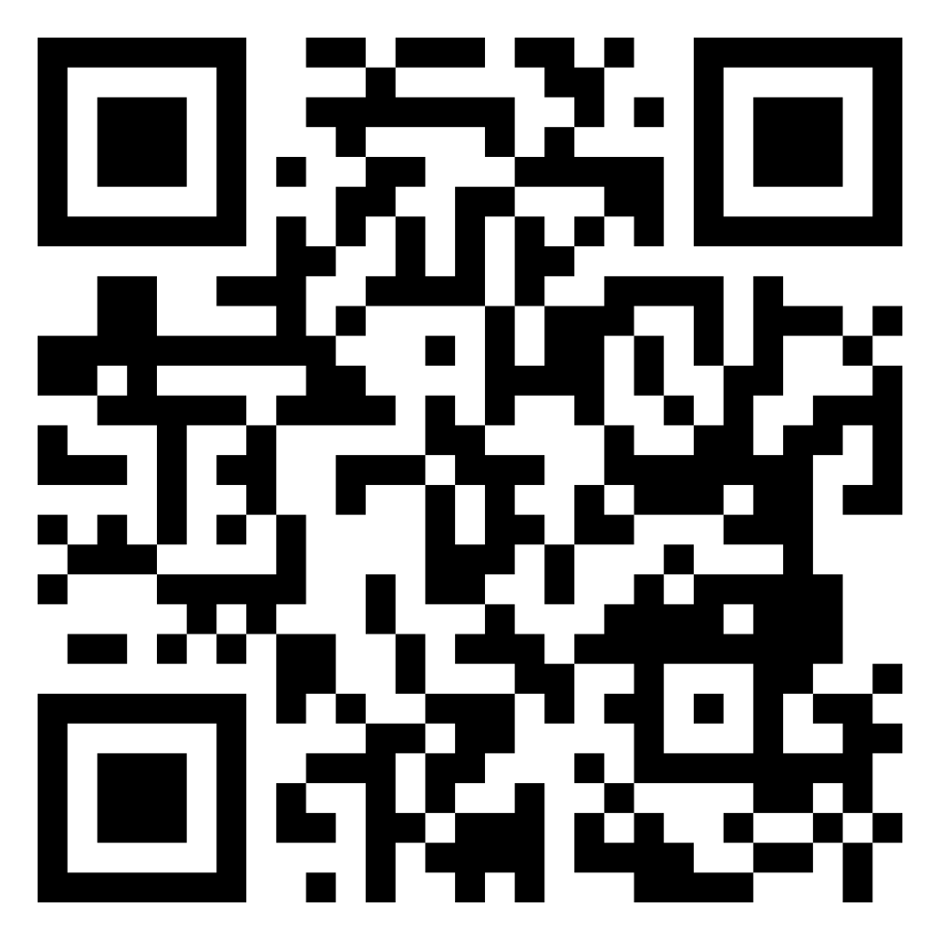



Investigating the Validity of the MMPI-3 Eating Concerns (EAT) scale in a University Sample: Replication and Extension
Emma A. Shepherd, Nicole M. Morris, M.A., M.S., & Paul B. Ingram, PhD.
Department of Psychological Sciences, Texas Tech University
Download this Poster
Emma.shepherd@ttu.edu
@IngramPsychLab
Ingramlab.wordpress.com
Introduction
Results
Conclusions
RATIONALE
Criterion Measure | EAT | Self-Report Behavior Correlates | EAT
BULIT-R Total Score | .69** | Past 12 months…
EAT-Q Total Score | .50** | Counted Calories | .04
Restraint subscale-avg. score | .33** | Counted Macros | .17**
Eating Concerns subscale-avg. score | .29** | Calculated Body Mass Index | .10
Shape Concerns subscale-avg. score | .41** | Compensatory Exercise | .28**
Weight Concerns subscale- avg. score | .28** | Used apps to track health/diet | .18**
EAT-26 Total Score | .63** | Read Fitness Blogs or Websites | .02
Dieting subscale | .56** | Followed or watched fitness coaches on social media | .09
Bulimia & Food Preoccupation subscale | .71** | Tracking on phone app…
Oral Control subscale | .39** | Counting Calories | .02
EPSI Total Score | .53** | Track what you eat | .08
Body Dissatisfaction subscale | .49** | Record workouts | .07
Binge Eating subscale | .59** | Count Macros | .11
Cognitive Restraint subscale | .29** | Record Weight | .09
Purging subscale | .53**
Restricting subscale | .38**
Excessive Exercise subscale | .21**
Negative Attitudes towards Obesity subscale | .21**
Muscle Building subscale | .04
IBBS Avg. | .19**
IES Avg. Score | -.22**
Unconditional Permission subscale | .12*
Reliance on Hunger and Satiety Cues subscale | -.45**
Body-Food Choice Congruence subscale | -.38**
Eating for Physical Rather than Emotional Reasons subscale | .24**
MBAS- AVG. Score (MBAS is a male only measure, N=110) | .45**
Muscularity subscale | .25**
Low body fat subscale | .55**
Height subscale | -.01
EDDS Total | .68**
ASSOCIATIONS
EAT scale scores generally demonstrated medium to large associations with body dissatisfaction, purging, binge eating, dieting and shape/weight/eating concerns.
EAT scale scores demonstrated small associations with fasting, weight and BMI checking, and macro counting .
More modest associations were demonstrated with self-report eating and exercise behaviors in the past 12 months; with compensatory exercise providing the strongest relationship and is a potential area of future study.
Nonsignificant associations were demonstrated between EAT scale scores and scales measuring excessive exercise, muscularity, and low body fat.
LIMITATIONS
Because this population sample was composed of college students, further validation in other populations including disordered eating treatment programs is needed.
Eating pathology is a low frequency behavior, creating a need for further recruitment and investigation, specifically for people with eating pathology disorders.
FUTURE DIRECTIONS
Some populations are at heightened risk of eating pathology. Research evaluating differential validity is needed for these groups (e.g., LGBTQIA+).
Broadband measures of psychopathology and personality have historically excluded eating pathology from their content domain, making diagnosis and treatment more challenging.
The most recent version of the MMPI, the MMPI-3, includes a new addition known as the Eating Concern Scale (EAT), giving the MMPI-3 unique abilities to asses eating pathology.
To examine the construct validity of the EAT subscale scores with both self-report and behavioral criterion measures.
STUDY OBJECTIVE
Method
PARTICIPANTS3
370 college students
28.4% male
57.3% White, 20.5% Hispanic/Latinx
19.9 years old (SD=4.13)
Participants were recruited using a psychology research pool known as the SONA system and specialized recruitment was used to pursue minority populations (i.e. LGTBTQ+, those with evidence of eating pathology).
Due to COVID-19, data collection was conducted remotely via Zoom; best practices were used as outlined in Corey & Ben-Porath (2020).
Research Assistants monitored participants to ensure valid data was being collected, aid with technical difficulties, and record any behavior needing review.
PROCEDURE
Notes. BULIT-R=Bulimia Test Revised, EAT-Q=Eating Disorder Examination Questionnaire, EAT-26=Eating Attitudes Test, EPSI = Eating Pathology Symptom Inventory, IBBS=Ideal Body Stereotype Scale-Revised, IES=Intuitive Eating Scale, MBAS=Male Body Attitude Scale Correlations, EDDS= Eating Disorder Diagnostic Scale. *.Correlation is significant at the 0.05 level (2-tailed) **. Correlation is significant at the 0.01 level (2-tailed).

