Slide 1
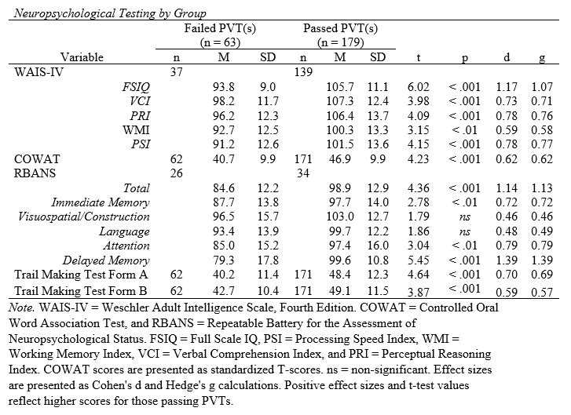
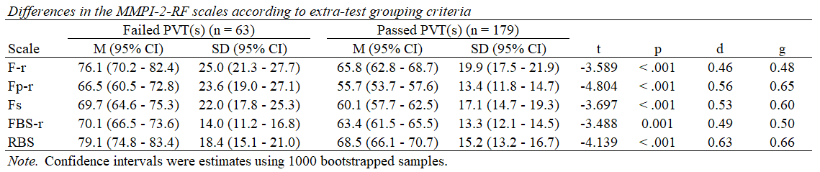
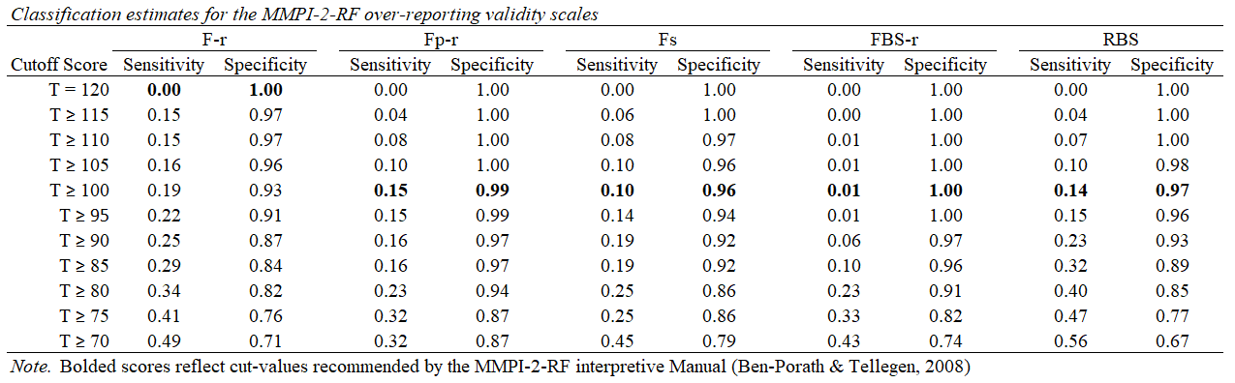

Evaluating the Minnesota Multiphasic Personality Inventory-2-Restructured Form (MMPI-2-RF) over-reporting scales in a military neuropsychology clinic.
Brittney L. Golden, B.A.¹, Paul B. Ingram, PhD.¹, & Patrick Armistead-Jehle, PhD., ABPP-CN²
¹Department of Psychological Sciences, Texas Tech University
²Munson Army Health Center, Leavenworth, KS
Introduction
Results
Conclusions
RATIONALE
There is a shortage of research evaluating the efficacy of the MMPI-2-RF over-reporting scales within active duty military samples.
Clinical needs and evaluative contexts common to active duty personnel are unique from other populations
Military service commonly influences response style and common clinical presentation
The efficacy of the over-reporting scales within an active duty personnel population may differ
STUDY OBJECTIVE
Examine the relationship between MMPI-2-RF over-reporting scales and performance validity testing (PVT) in a military sample.
BETWEEN GROUP DIFFERENCES
Significant differences exist between those passing and failing PVT(s) on all of the over-reporting scales
Within group variability was high, which served to decrease effect size estimates of between-group difference
Those failing PVT(s) demonstrated lower performance on available neuropsychological measures.
Scales differences are most frequently medium effects
> None had a large effect (d ≥ |.8|)
> All had at least a small effect (d ≤ |.2|)
Effect sizes observed in active duty samples are smaller than those seen in other settings (e.g., Ingram & Ternes, 2016)
RBS scale demonstrated the largest effect size
F-r and FBS-r demonstrated the smallest differnces
SENSITIVITY AND SPECIFICITY
MMPI-2-RF over-reporting scales have high specificity and low sensitivity
Most individuals meeting or exceeding cut scores on the MMPI-2-RF over-reporting scales also fail PVT(s)
Those who failed PVT(s) frequently do not elevate the MMPI-2-RF over-reporting scores to a level indicative of profile invalidity
> This likely predicts, in part, the poor sensitivities
In this military sample there was a demonstrated relationship between the MMPI-2-RF validity scales and PVTs, however these constructs are dissimilar and thus warrant separate measurement.
LIMITATIONS
Variability in validity scale estimates of effect may be due to:
> Administration of different PVT(s)
> Different diagnostic presentations across participants
Meaningful grouping variables conveying differential effort could not be created because not all participants were administered the same PVT(s)
Slick criteria was unable to be established for the sample
A minority of the sample was Medical Board-involved, and those individuals may differ in their presentation
FUTURE DIRECTIONS
Examine differential levels of effort (e.g., all fail, some fail, fail none) within active duty military samples
Explore the role of contextual factors (e.g., culture, genuine psychiatric problems) in non-credible responding
Method
PARTICIPANTS
242 active duty US Army service members
88.8% Male
73.1% White
34.4 years old (SD = 8.4)
14.8 years of education (SD = 2.5)
50.8% reported history of mTBI or concussion
80% diagnosed with a psychiatric condition:
> PTSD (8.7%)
> Depressive disorder (19.4%)
> PTSD and a depressive disorder (2.5%)
> Attention deficit disorder (7.4%)
> Anxiety disorder (28.1%).
PROCEDURE
Testing was conducted by a technician and interpretation was done by a board-certified neuropsychologist.
Participants were grouped based on their performance on PVTs (pass all/failed at least one)
All participants were administered at least one PVT:
Test of Memory Malingering (TOMM)
Effort Index of RBANS
Medical Symptom Validity Test (MSVT))
Participant Groups were demographically similar
Failed PVTs (n = 63)
Passed PVTs (n = 179)

