Slide 1

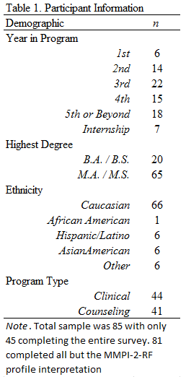
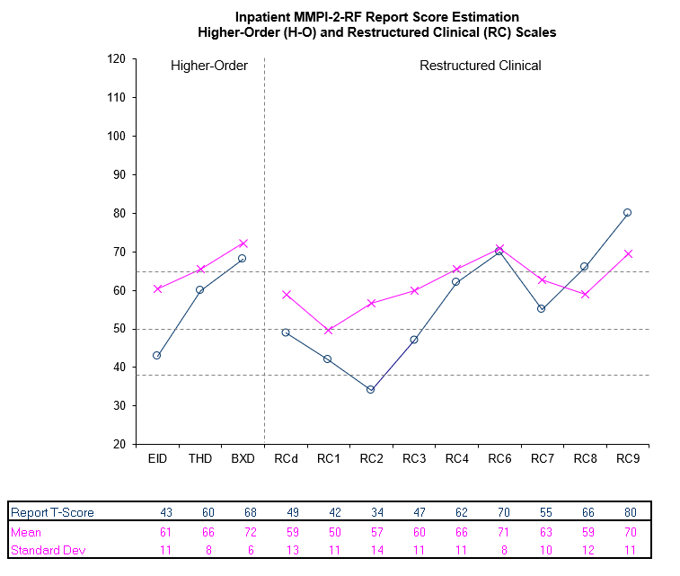
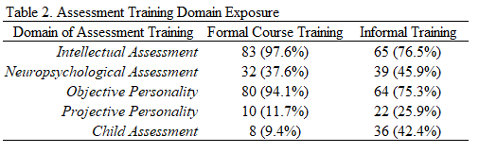
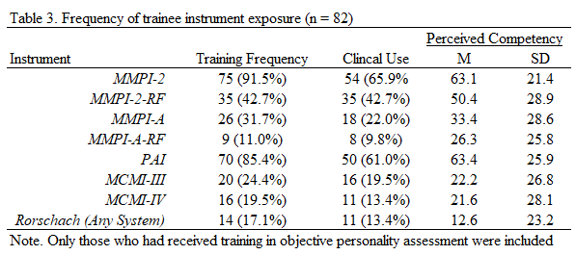
Training Trends in the Interpretation of the
MMPI-2/MMPI-2-RF/MMPI-A/and MMPI-A-RF
Paul B. Ingram, PhD., Matthew Cribbet, PhD., and Adam T. Schmidt, Ph.D.
Rationale:
Participant Characteristics:
MMPI-2-RF Report Estimation
Assessment is a core competency of clinical practice for the American Psychological Association (Rodolfa et al., 2013). A recent survey found a majority of psychologists affiliated with APA Division 12, Clinical Psychology, regularly conduct assessments (Norcross & Karpiak, 2012) with only 20% not including any in their work (Wright et al., 2016). Despite being a frequent component of the field, training in personality assessment represents an area of growth for psychologists (Kaslow & Egan, 2017). In general, the quality and consistency of personality training is not known (Ready & Veague, 2014) and what little work that has been done to increase interpretation standardization and survey training competency has excluded personality assessment as a domain.
Accordingly, this research endeavors to summarize training trends in the use and interpretation of personality instruments across a preliminary sample of doctoral training programs. This research evaluates frequency of instrument use, perceived competency, and (in the case of the MMPI-2-RF) consistency in training outcomes.
Independent sample T-tests were conducted to examine training differences between clinical and counseling programs. Selected comparisons are presented below:
•Number of psychological reports
T (80) = -1.40, p = ns, M = 6.1, SD = 3.6
• Semesters of clinical practice
T (80) = 0.80, p = ns, M = 10.1, SD = 13.3
• Desire for more personality training
T (80) = 2.22, p = .03 (Clin > Cou), d = .48
• Need for personality training
T (80) = 1.20, p = ns
• How much additional training
T (50) = 0.88, p = ns
Note. 32 had training on the RF and 13 did not. All had training on the MMPI.
Method:
Discussion Points
In a sample of 12 APA-accredited Ph.D. programs in Clinical and Counseling Psychology (6 Clinical and 6 Counseling), Directors and Associate Directors of Training were asked to forward a recruitment e-mail to their respective programs. In this e-mail, participants were informed that in exchange for participation they would be paid $5.00 in an Amazon gift card. Programs were selected from 7 different states across the country and programs selected were highly reputable within the field and all had strong outcome metrics (e.g., EPPP pass rate and internship match rate to accredited programs).
Trainees were asked to describe perceived competency, frequency of use during practicum, frequency of training for different personality assessment instruments. Based on a MMPI-2-RF sample report selected from the Pearson website, trainees were also asked to estimate T-scores based on the qualitative interpretive report.
The MMPI-2 is more frequently trained than the MMPI-2-RF, Despite training frequency discrepancy, the RF is closer to the MMPI-2 in clinical use suggesting that training practice does not appropriately emphasize instruments in practice
Applied use of the MMPI-2/MMPI-2-RF during graduate training reflect rates seen in overall instrument utilization trends (Ben-Porath, 2017)
Differences in MMPI-2-RF scale estimation does not vary based on training for these two instruments, supporting the use of the RF given it’s superior psychometrics
The MMPI-2-RF is a core component, and generally accepted aspect, of personality assessment training programs
Clinical and Counseling Programs were generally not distinctive in training perceptions or practices

