Slide 1
Validity Scales:
Patterns Observed across Veteran Affairs Settings
Paul B.Ingram^{ab}, Anthony M. Tarescavage^{c}, Yossef S. Ben-Porath^{d}, & Mary E. Oehlert^{b}
a. Texas Tech University, b. Eastern Kansas Veteran Healthcare System, c. John Carrol University, d. Kent State University

Slide 2
Project Background and Context
7-year national Sample of MMPI-2 and MMPI-2-RF Administrations
All service locations within the VA included (Stop Codes)
Investigation focuses on outpatient services
VA is unique in its evaluative complexity
Notes:
Outline study background, discuss sample and scope of this project
-- talk about validity scales within the VA

Slide 3
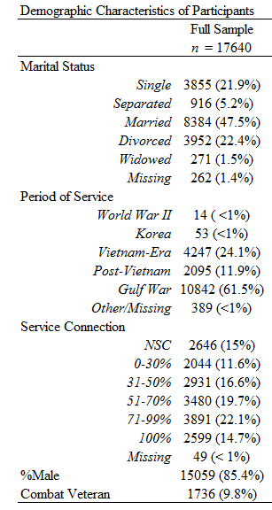
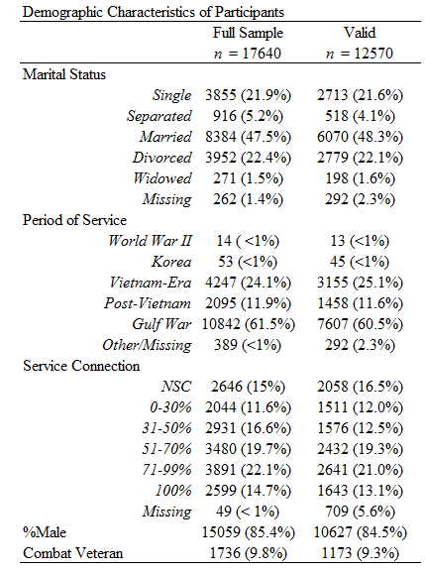
Invalidity Criteria: CNS ≥ 18, VRIN-r ≥ 80, TRIN ≥ 80, F-r ≥ 120, and Fp-r ≥ 100.
Notes:
-- Contrast with Previous VA groups
------ Era breakdown focuses more on Gulf War (e.g., DS1 and OEF,OIF,OND) compared to comparison groups gathered for MMPI-2 [so too with declined others conflicts- WW1 gone, WW2/Korea down, etc]
------ Service Connection is also substantially higher here (45% with SC in psych inpatient comparison group, 15% here WITHOUT SC) suggesting importance of evaluating validity scales
-- Contrast two groups and note similarity between valid / full sample
Questions about why SC isn’t different may reflect that this does not capture ongoing evaluations / desire for evaluations (e.g., Nelson and colleagues, 2010)

Slide 4
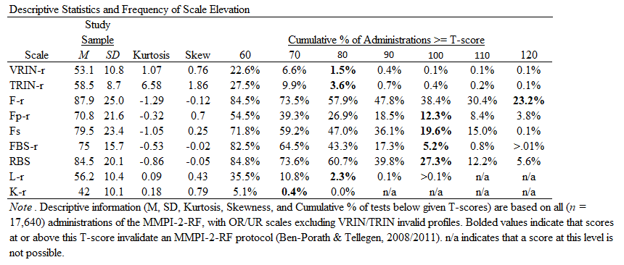
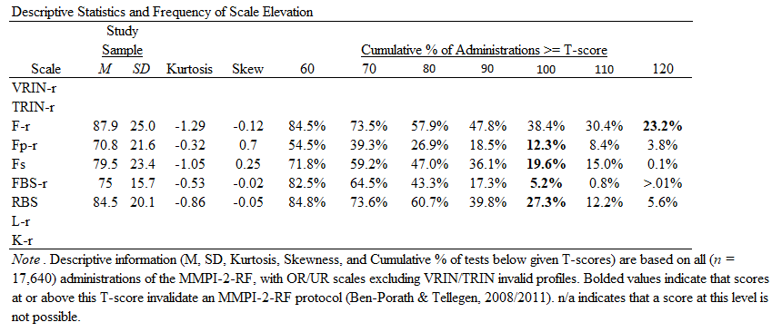
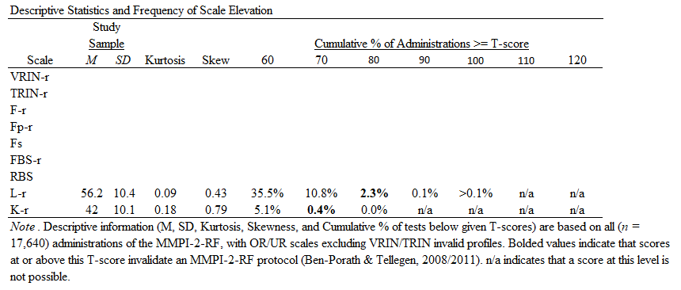
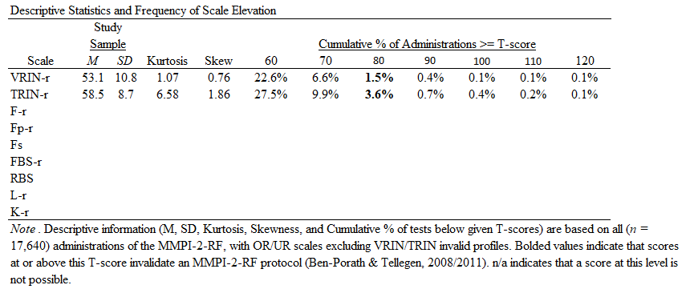
Overall Scale Cumulative Frequencies
Notes:
Non-Content Based Scales,
--- Small portion invalidated through this scale.
--- slightly more frequently a fixed responding pattern than random responding
Over-Reporting Scales
--- substantial portions have elevations which invalidate
--- even higher rates classified as within a range which might suggest potentially exaggeration of symptoms
Under-Reporting
--- Minimal evidence of this pattern

Slide 5
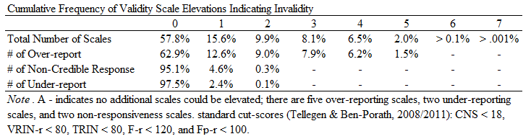
Frequency of Multiple Scale Elevations
Notes:
---Numbers reflect post NCR exclusion
---37.1% invalidate an over-reporting scale
---Twice as likely to invalidate on multiple over-reporting scales (24.6%) when you are part of that 37.1%

Slide 6
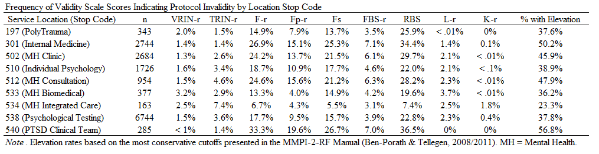
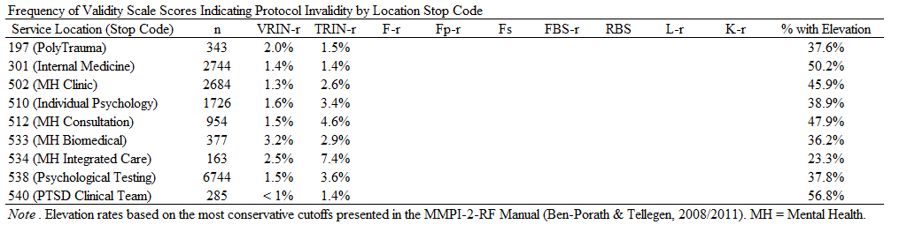
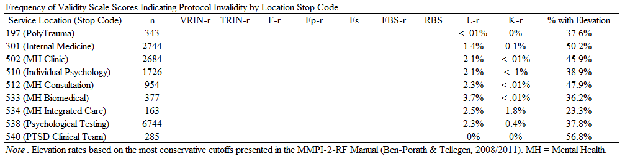
Invalidity By Stopcode
Notes:
Going out of order for a reason that should become apparent.. NCR, UR, then OR
Substantial variation across context in rates of invalidity for individual scales and for RF overall.

Slide 7
Conclusions
High frequencies of invalidity observed
Frequency of uninterpretable profiles varies by service location
Over-reporting is most frequent invalidity pattern
Most with one over-reporting elevation have multiple scales invalidated

